Slide 1
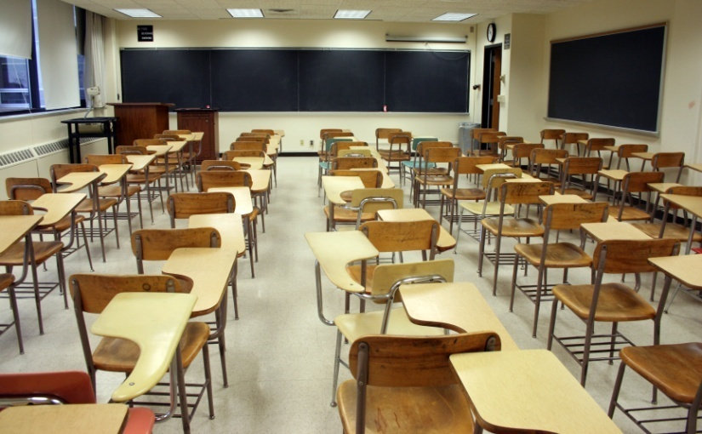
Active Supervision
Susannah Brackett
University of Pittsburgh
Photograph by Igoghost
Notes:
This presentation will focus on the use of active supervision and is written and narrated by Susannah Brackett.

Slide 2
Contents
Introduction
Definition
Glossary
Summary of Research
How Active Supervision is used
Case Study
Active Supervision: Step-by-Step
Active Supervision Do’s
Active Supervision Don’ts
FAQs
References
Notes:
On this slide you will find the contents of this presentation.

Slide 3
PBIS and Active Supervision
Positive behavioral interventions and supports (PBIS) are school-wide evidence-based academic and behavioral strategies that are used to improve outcomes for all students.
Active supervision fits into the category of PBIS since it is evidence-based and can prevent behavior problems from occurring.
Active supervision can also be implemented
as a school-wide intervention.
Notes:
Positive behavioral interventions and supports or PBIS are academic and behavioral strategies that are used in schools to improve outcomes for all students. Active supervision is included in the category of PBIS since it is an evidence-based practice and, when used correctly, can help to prevent serious behavior problems from occurring. It contributes to a better learning environment for all students. This is also something that can be implemented school-wide not only by teachers, but other adults and professionals in the building.

Slide 4
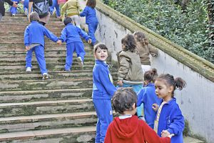
What is Active Supervision?
Active supervision is a proactive approach used in school settings to monitor a large area in order to ensure safety and reduce problem behaviors.
This intervention is most commonly used in non-classroom settings where there may be less adult direction and supervision.
Appropriate student behavior is supported and reinforced while inappropriate behavior is corrected.
Photograph by Subiendo
Notes:
So, what is active supervision?
Active supervision is a proactive intervention. It is used to monitor a large area of students ensuring the safety of all while reducing and preventing problem behaviors from occurring.
It is most commonly used in non-classroom settings such as the cafeteria or playground since these types of settings often have less adult direction and supervision and this is when most behavior problems tend to occur.
By scanning and moving around the area while interacting with the students, staff members support and reinforce appropriate behavior and correct inappropriate behavior.

Slide 5
Glossary of Terms Related to Active Supervision
Precorrection – A strategy used to prevent undesirable behaviors from occurring by teaching and reminding students of the rules and routines so that they know what is expected and how to behave.
PBIS - Positive behavioral interventions and supports are school-wide evidence-based academic and behavioral programs that are used to improve outcomes for all students.
Notes:
These two terms, precorrection and PBIS are both important to be familiar with in order to understand the process of active supervision.
Precorrection is a strategy used to prevent undesirable behaviors from occurring by teaching and reminding students of the rules and routines so that they know what is expected and how to behave.
PBIS stands for positive behavioral interventions and supports. These strategies are school-wide evidence-based academic and behavioral programs that are used to improve outcomes for all students.

Slide 6
Summary of Research
Haydon & Scott (2008)
Elementary school in southern Illinois
400 students gathering in gym prior to start of school day
Studied the use of active supervision and precorrection
Strategies were found to be effective
Notes:
We’re now going to look at a few research studies that have focused on active supervision.
In 2008 Haydon & Scott researched how the staff in one elementary school in southern Illinois implemented various examples of active supervision and pre-correction to supervise the approximately 400 students in the gym before school daily. They described how an effective instructional setting is developed and then how these steps were applied to this setting. The strategies used were found to be effective and were maintained one year later.

Slide 7
Summary of Research (cont.)
Helmke & Schrader (2001)
Investigated the effectiveness of independent student practice on classroom achievement
Success was found to be dependent on teachers management, preparation, intensive supervision and contacts with students
Notes:
In 2001 Helmke & Schrader investigated the effectiveness of independent student practice on classroom achievement. This article discusses what it takes for a teacher to make student seatwork effective including the teacher’s management, preparation, intensive supervision, and contacts with students. The results of this study found that it is not the amount of time spent on seatwork that influences the effectiveness. Rather, success is more dependent on the previously described conditions.

Slide 8
Summary of Research (cont.)
Johnson-Gros, Lyons, & Griffin (2008)
Studied the effectiveness of active supervision for reducing problem behaviors in hallway
Three steps of active supervision described:
Scan the area
Move around entire location
Interact with students
Active supervision found to be effective
Notes:
Johnson-Gros, Lyons, & Griffin (2008) discuss active supervision as one form of Positive Behavior Support (PBS) and as an effective strategy for reducing problem behaviors in the hallway of high schools. The three steps of active supervision are defined and discussed in regard to this particular example. These the steps are: scanning the area for students who are following or violating rules; moving around the entire location, especially areas where problems are more likely to occur; and interacting with the students. Pre-correction is also defined and discussed. The results of this study found that active supervision was effective in decreasing the number of tardies received by the students.

Slide 9
Summary of Research (cont.)
Lewis, Colvin, & Sugai(2000)
Elementary school playground
Studied effectiveness of precorrection and active supervision for managing problem behaviors
Rates of active supervision by playground monitors also studied
Rates of problem behaviors decreased even though rates of active supervision did not
Notes:
In a study by Lewis, Colvin, & Sugai(2000) an elementary school playground was the setting for this study of the effectiveness of implementing a pre-correction and active supervision strategy for managing problem behaviors. The rates of problem behavior by the elementary students were studied as well as the rates of active supervision by playground monitors. The results found that although the rates of active supervision did not appear to increase, the rates of problem behavior did, in fact, decrease.

Slide 10
Summary of Research (cont.)
Oswald, Safran, & Johanson (2005)
Problem hallway behaviors of middle school students
Multi-component positive behavior support (PBS) intervention
Found to be effective in managing the disruptive behaviors targeted
Notes:
Oswald, Safran, & Johanson (2005) tested a multi-component Positive Behavior Support (PBS) intervention in order to find whether this would improve problem hallway behaviors of middle school students. This intervention included positive practice, pre-correction, verbal praise, reinforcement, correction of inappropriate behavior, active supervision, discussion of behavior with students, and on-time dismissal. This study found the multi-component intervention to be an effective way to manage the disruptive behaviors that were targeted.

Slide 11
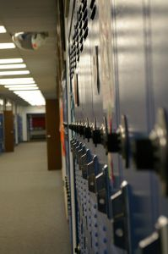
How Active Supervision is Used
Active supervision can be used in any school setting in which there is a large number of students, most commonly the gym, hallways, playground, etc.
It has been found to be effective for all ages of students.
Photograph by benkersey
Notes:
How is active supervision used?
Although active supervision is most commonly used in non-classroom settings such as the gym, hallways, or the playground, it can be used in any school setting in which there is a large number of students. This includes a classroom setting such as when students are working more independently or in groups.
This intervention has also been proven to be effective with all ages of students from preschool through high school age.

Slide 12
Case Study: Part 1
Second grade recess at West Elementary school
Students are getting in trouble for hitting, grabbing, pushing, and tripping others
Recess monitors sit on bench on one side of playground and blow whistle to yell at children
Most office referrals happening at this time every day
Notes:
Let’s take a look at a case study that shows the need for active supervision.
The staff at West Elementary School just don’t know what to do any more about the behavior during second grade recess. There is a lot of hitting, grabbing, and pushing occurring, as well as children being tripped by jump-ropes and hula hoops. The children are warned every day before they go out to recess that if they don’t behave appropriately they will not get to play the next day. Still, there are at least three or four of the same children in the principal’s office by the time their teacher comes to pick them up from recess every day. There are always two staff members monitoring recess and they sit on a bench on one side of the playground and chat with each other while the children play. These recess monitors blow their whistles and yell when they see inappropriate behavior occurring, but do not often leave the bench unless they need to take a child inside to see the principal. Second grade recess is the time when the most behavior problems and office referrals are occurring and the staff just doesn’t know what they can do to improve the students’ behavior.
Later in the presentation we will revisit this case study to see what happens

Slide 13
Active Supervision: Step-by-Step
Constantly scan the entire area looking for problem behaviors or dangerous activity.
Keep moving.
Travel by areas/activities/groups that are known to cause problems.
Check for appropriate and inappropriate behavior being certain to praise or correct as necessary.
Notes:
When carrying out active supervision there are a few steps that should be followed in order to make sure it is effective.
The staff member should be constantly scanning the entire area, both looking and listening. They will be checking that nothing dangerous happens or that problem behaviors are occurring.
While doing this, they must also be moving around the area in an unpredictable but purposeful way. In this way, they should make sure to target areas, activities, or groups that are known to be problematic.
While doing this, the staff member will be checking for both appropriate and inappropriate behavior and praising it or correcting it as necessary. Continuously interacting with the students is important.

Slide 14
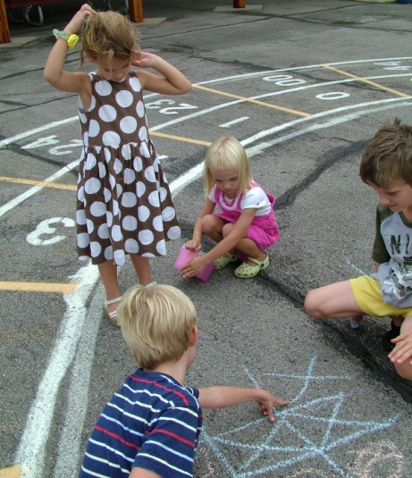
Active Supervision Do’s
Keep your eyes and ears open to scan the area.
Move around the entire area.
Target problem areas/activities/groups.
Praise appropriate behavior.
Correct inappropriate behavior immediately and calmly.
Photograph by hortongrou
Notes:
Some important do’s when using active supervision include: Keep your eyes and ears open at all times in order to effectively scan the entire area.
Continuously move around the whole area you are supervising while making sure to stop by problem areas/activities/groups more frequently that others.
Ensure that appropriate behavior is noted and praised while inappropriate behavior is corrected immediately and calmly.

Slide 15
Active Supervision Don’ts
Don’t…
sit or stand out of the way.
only interact with students to correct inappropriate behavior.
ignore inappropriate behaviors.
yell at students in a way that might embarrass or humiliate him or her.
Notes:
A few don’ts when using active supervision include: Sitting or standing out of the way or somewhere that the entire area being supervised cannot be seen.
Only interacting with students to tell them off or correct their behavior. Positive interactions are very important in active supervision.
Ignoring inappropriate behavior. It is important to correct such behavior before it becomes worse or becomes a safety issue.
Yell at a student in way that may embarrass or humiliate him or her. The student should be approached in a respectful and calm way, the rule should be restated for him or her and the consequence given immediately.

Slide 16
Case Study: Part 2
Staff members agreed to try active supervision to prevent the problem behaviors from occurring at recess
All recess rules are reviewed before recess begins every day
Recess monitors spend the time moving around the playground throughout entire recess
They interact with the children, praising or correcting the behavior
Office referrals and student injuries have decreased drastically
Notes:
Now let’s take a look back at our case study and see how things have changed.
One of the second grade teachers at West Elementary decided it was time to try something new. She had read about a strategy called active supervision that seemed like it might help with the problem they were having with recess behavior. Everyone concerned agreed that trying active supervision sounded like a good idea, so after researching it further, they began using this strategy. First, before recess every day now, the second grade teachers go over the recess rules with the students to make sure they remember them instead of just warning them not to behave inappropriately. The recess monitors no longer sit on the bench and talk while the children play. They can now be found walking around the entire playground area. As they walk around they talk to the children, either praising their appropriate behavior or correcting behaviors that are inappropriate. There are many less injuries during the second grade recess now and there are hardly ever any office referrals any more. The children and the adults all seem to enjoy recess a lot more now.

Slide 17
Frequently Asked Questions
What is the objective of active supervision?
What ages and environments does active supervision work best with?
What are some ways to acknowledge those students who are exhibiting appropriate behavior?
Notes:
Here are a few frequently asked questions about active supervision:
What is the objective of active supervision?
The objective of active supervision is to prevent and correct problems by moving among the students while watching and listening to them carefully and interacting with them in a positive way.
What ages and environments does this work best with?
Active supervision has been found to work with any age of children from preschool up through high school age. It is most commonly used in non-classroom settings such as gyms, hallways, and playgrounds where behavior problems often arise.
What are some ways to acknowledge those students who are exhibiting appropriate behavior?
There are many different ways in which to praise the students who act appropriately from a simple “good job” or “thank you” to privately handing them a small note explaining that you are proud of them for doing the right thing.

Slide 18
References
Haydon, T., & Scott, T. (2008). Using common sense in common settings: Active supervision and precorrection in the morning gym. Intervention in School and Clinic, 43(5), 283-290.
Helmke, A., & Schrader, F., W. (2001). Successful student practice during seatwork: Efficient management and active supervision not enough. Journal of Educational Research, 82(2), 70-75.
Johnson-Gros, K., Lyons, E., & Griffin, J. (2008). Active supervision: An intervention to reduce high school tardiness. Education & Treatment of Children, 31(1), 39-53.
Notes:
Here’s a list of sources used for this presentation. I hope that this powerpoint presentation has been helpful to you and thank you for listening.

Slide 19
References (cont.)
Lewis, T., Colvin, G., & Sugai, G. (2000). The effects of pre-correction and active supervision on the recess behavior of elementary students. Education & Treatment of Children, 23(2), 109.
Oswald, K., Safran, S., & Johanson, G. (2005). Preventing trouble: Making schools safer places using positive behavior supports. Education & Treatment of Children, 28(3), 265-278.
Photos from www.sxu.hu

