Slide 1
Addy Learns to Play
By Kimberly Allen

Slide 2
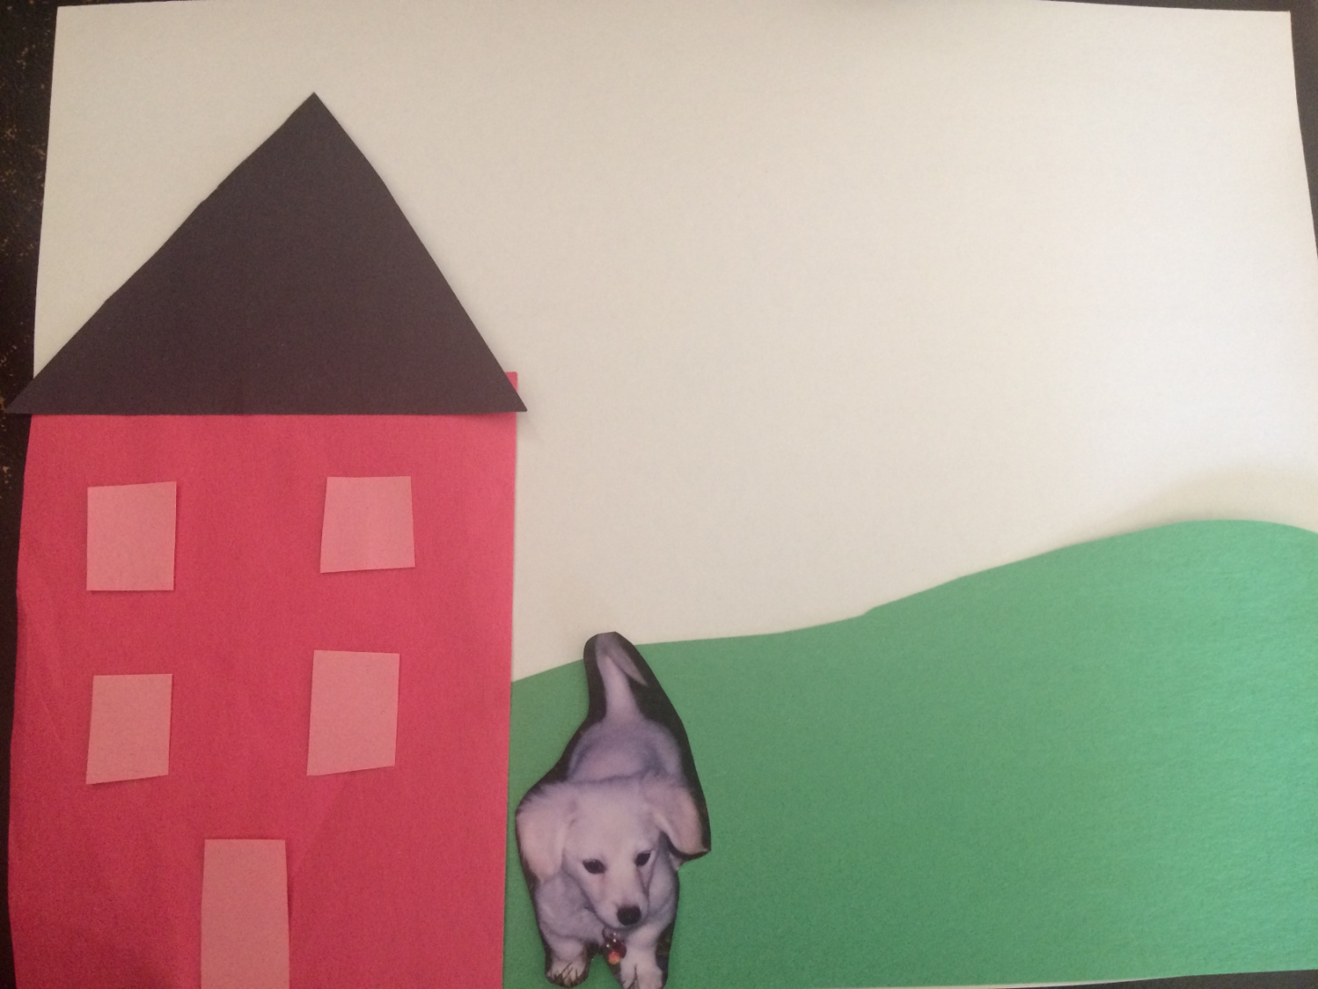
There once was a four year old dog named Addy. She lived with her mommy in a red brick house. Addy and her mommy loved to play together.

Slide 3
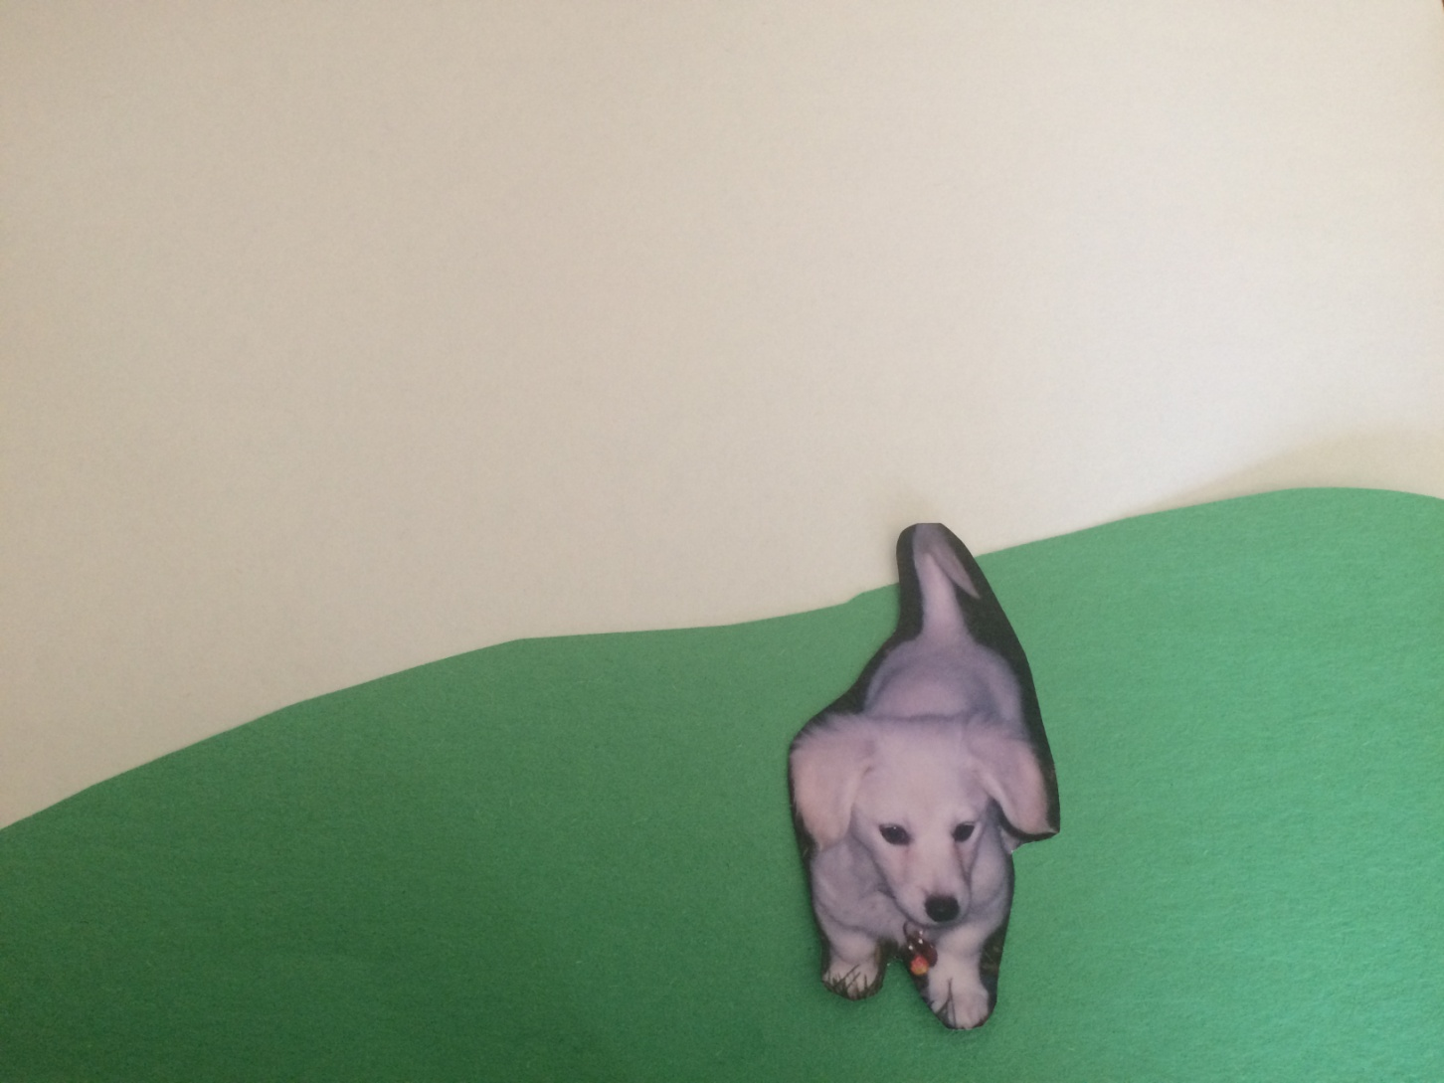
Addy loved to play with her gingerbread man toy and ball. When she played with her toys, she would run around and play by herself. Addy liked to play by herself.

Slide 4
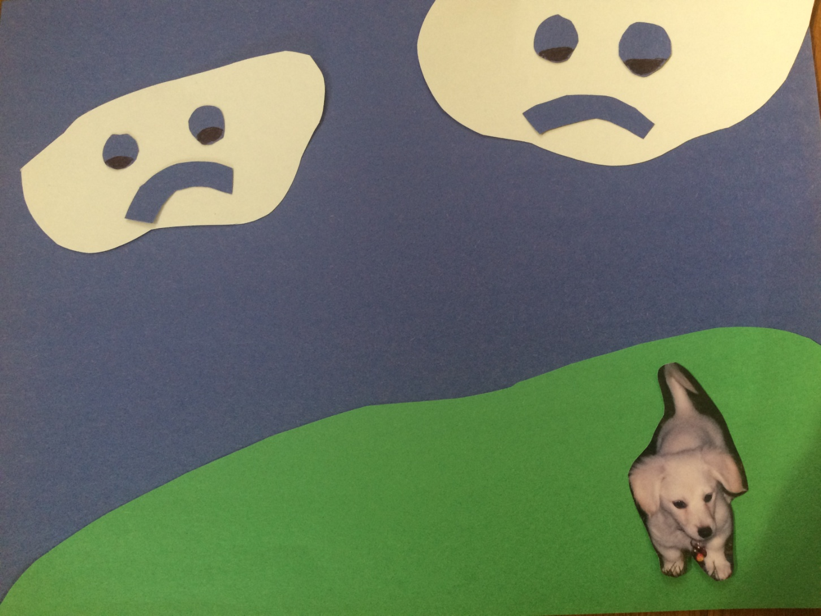
When Addy’s neighbor Oscar would come over to play, Addy would growl and bite him when he came close to her. This made her mommy sad.

Slide 5
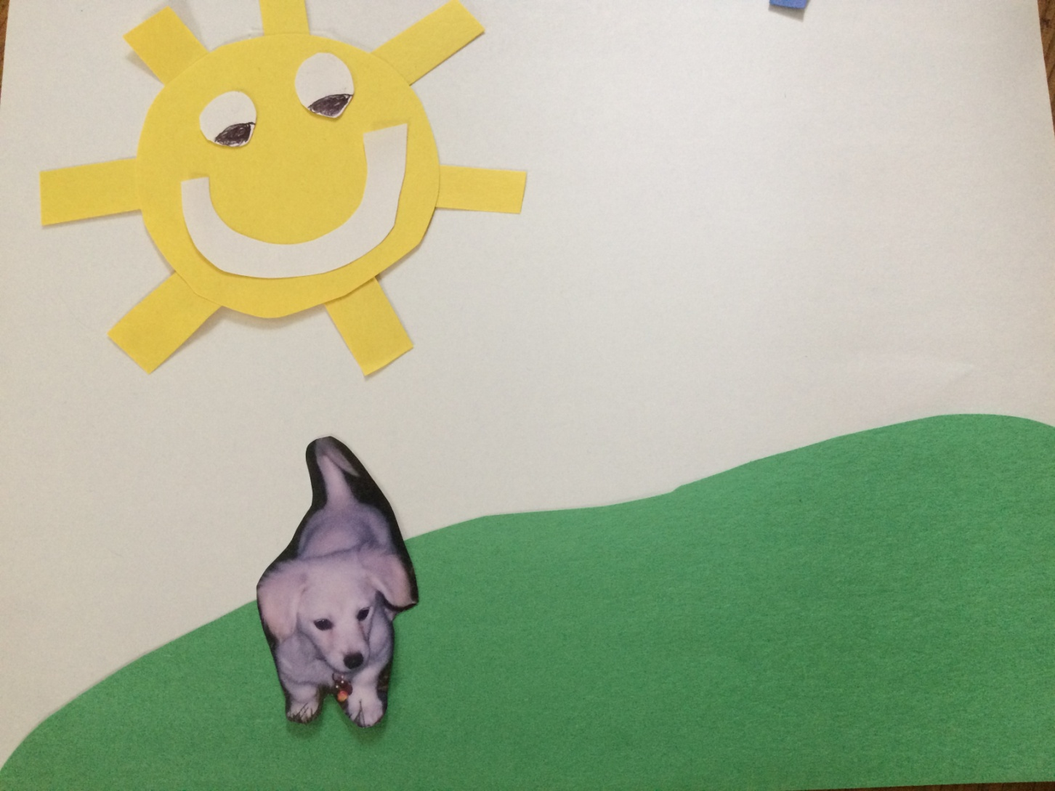
One day, Addy’s mommy had a great idea!

Slide 6
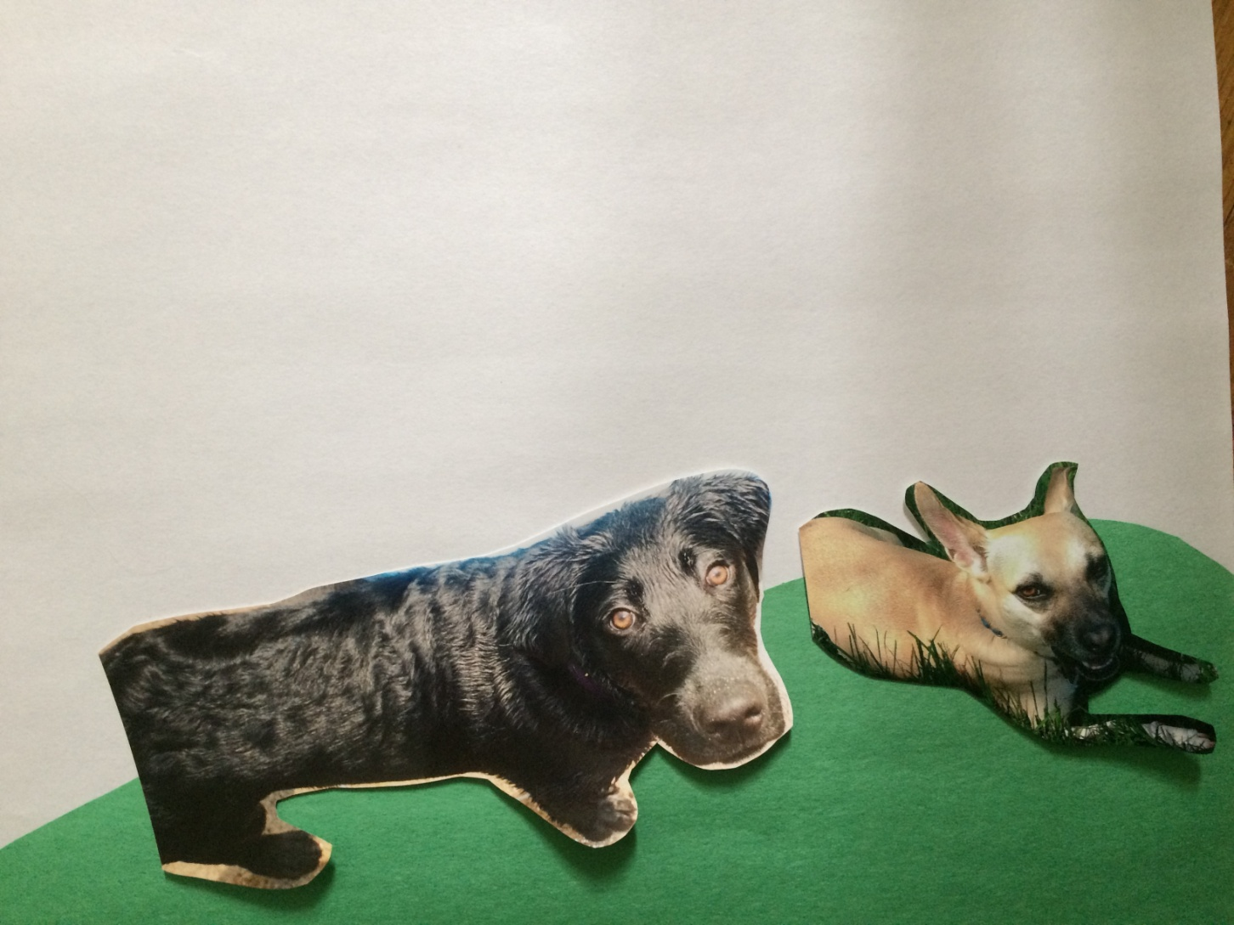
Addy’s mommy went over to Oscar’s house with her cell phone. She made two movies of Oscar and his friend Spot playing together.

Slide 7
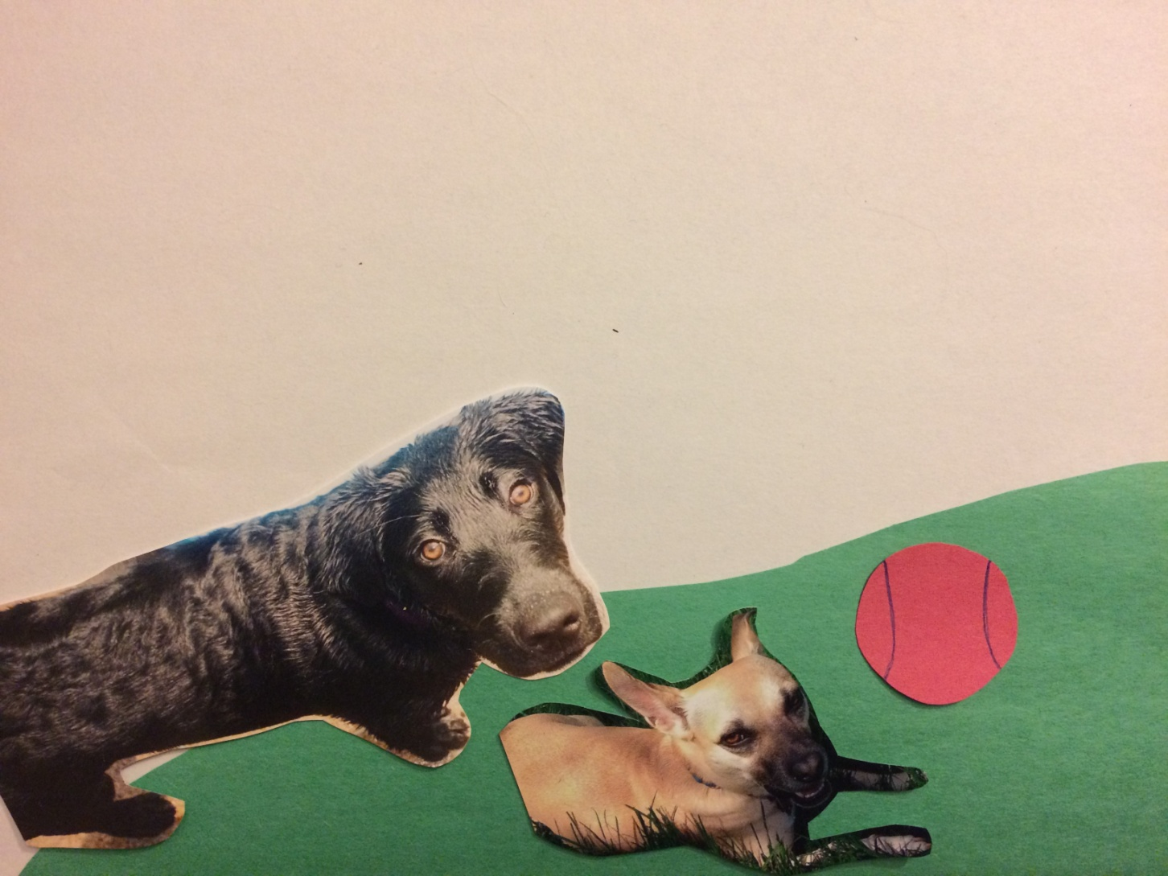
In one movie, the doggies played with the gingerbread man. In the other movie the doggies played with the ball.

Slide 8
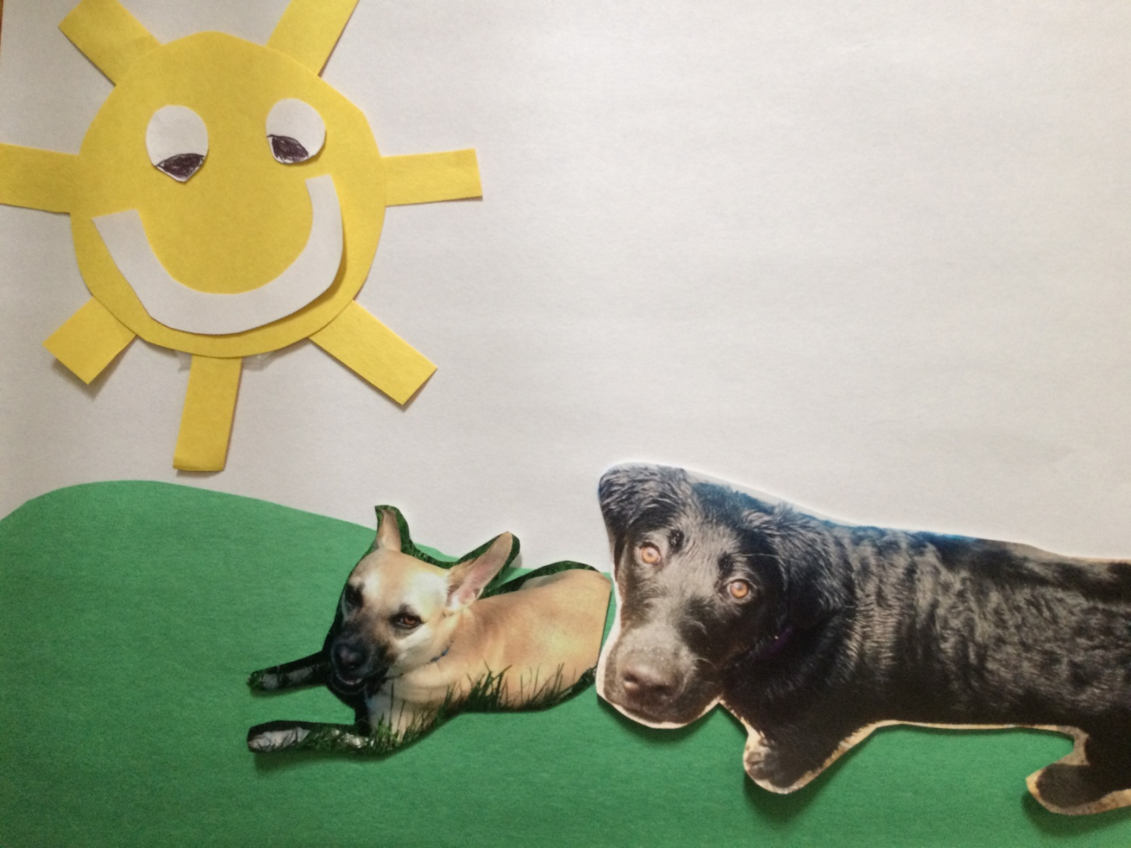
After making the movies, Addy’s mommy asked Oscar’s and Spot’s mommies if they could come over to play. They said yes!

Slide 9
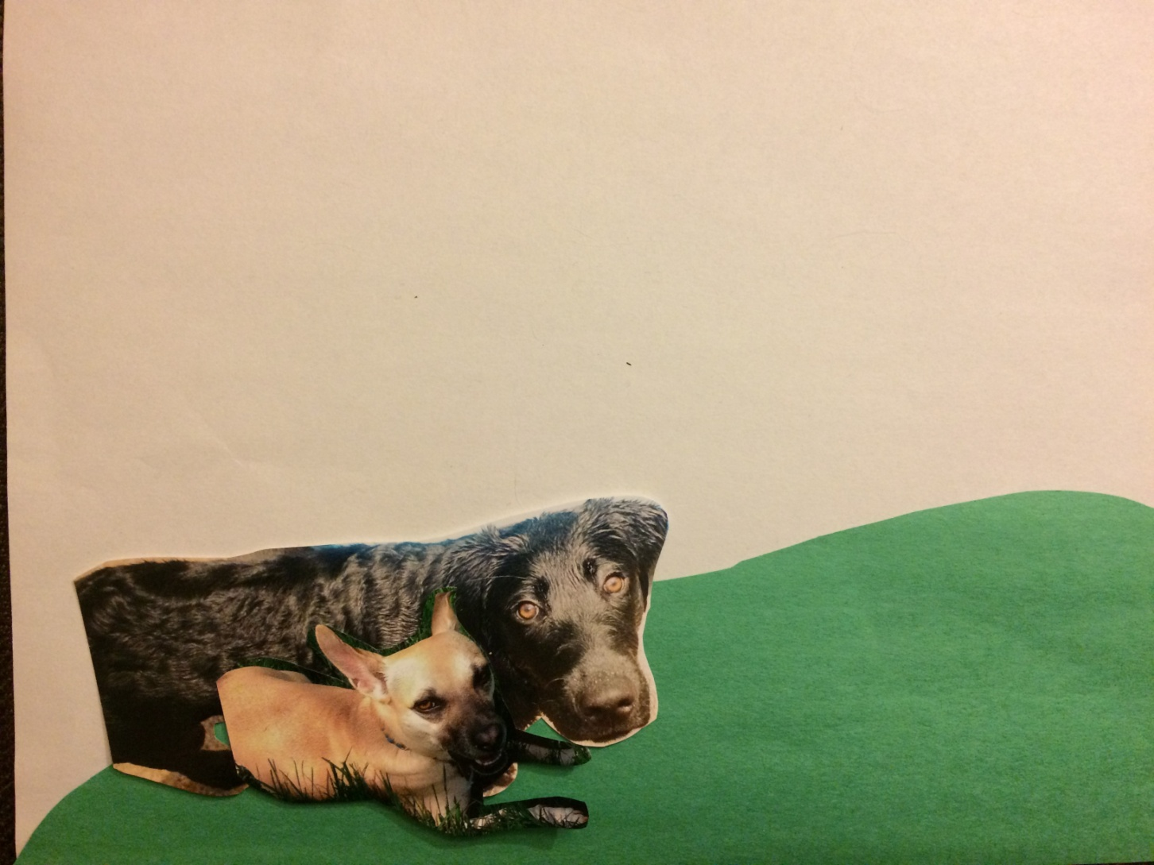
The movies showed the doggies playing nicely. They did not growl or bite each other. They took turns with the toys and sat next to each other while playing.

Slide 10
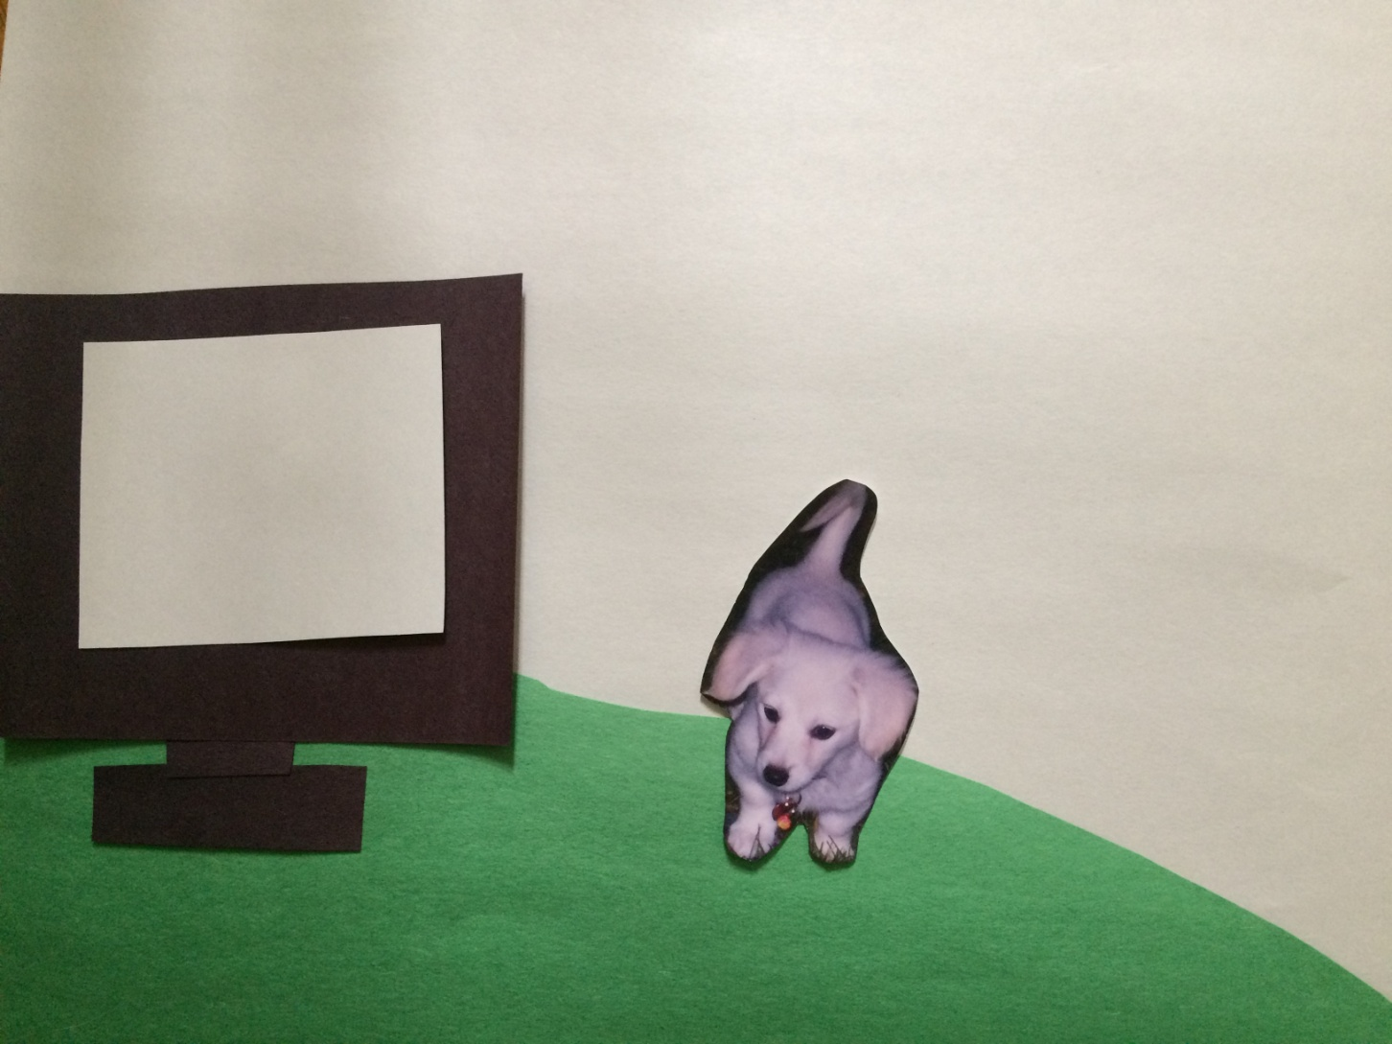
Before each play date, Addy’s mommy showed Addy the special movies of Oscar and Spot playing nicely together.

Slide 11
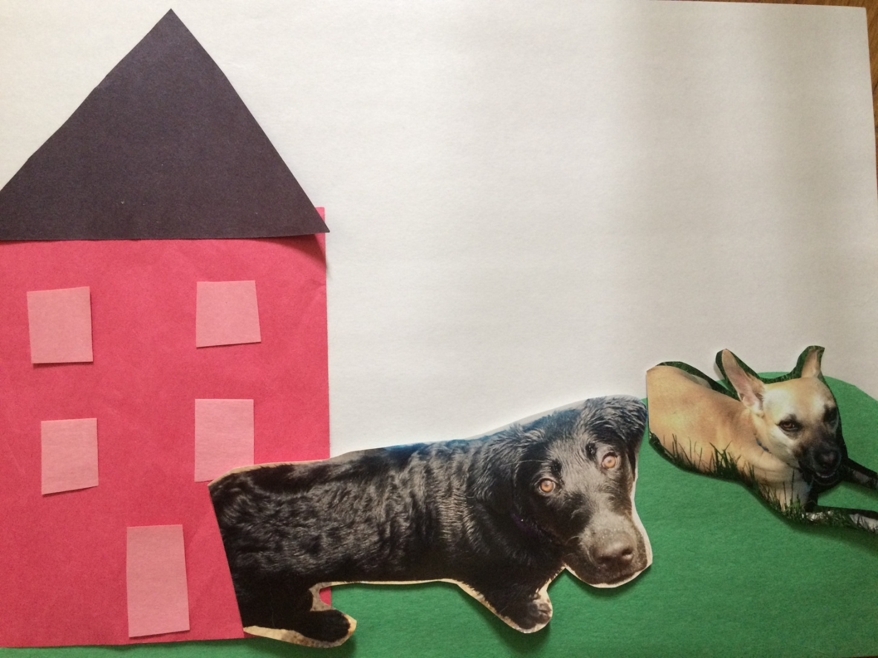
When the doggies came to Addy’s house they played with her two favorite toys, her gingerbread man and ball!

Slide 12
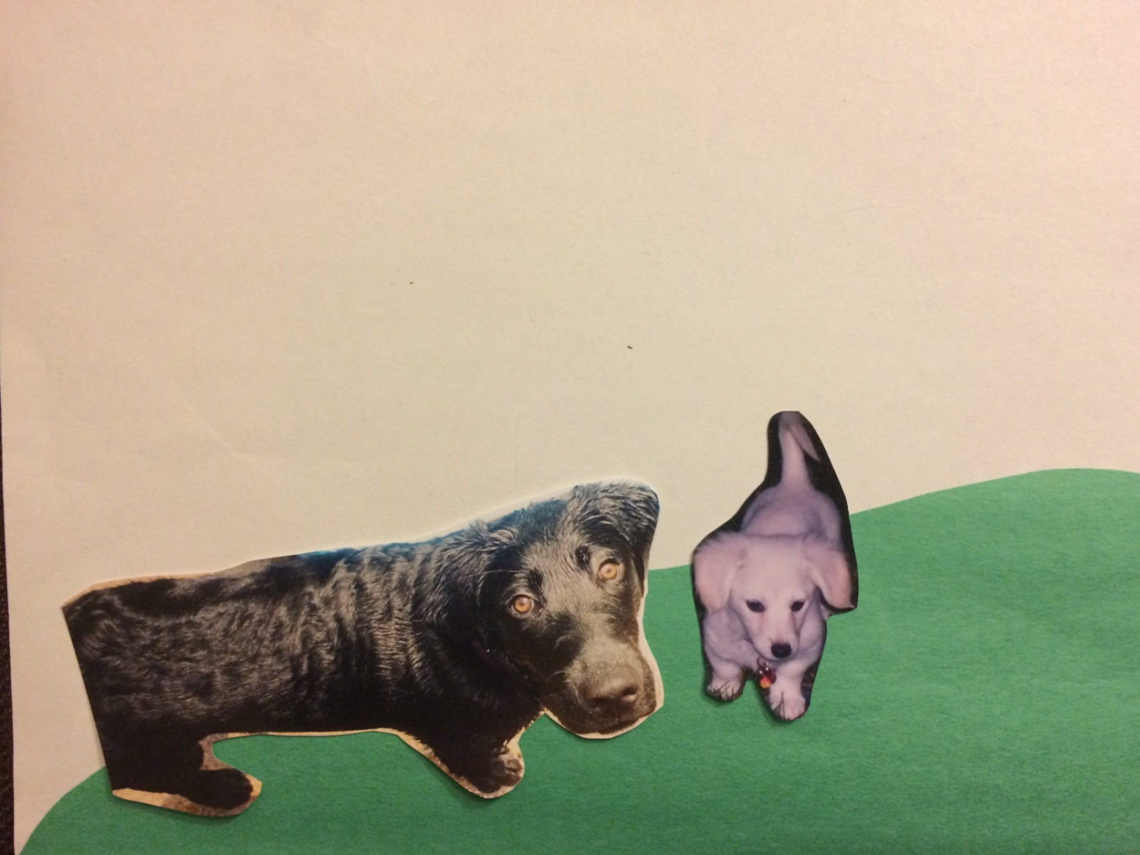
While the doggies played, Addy’s mommy made a movie of them playing together.

Slide 13
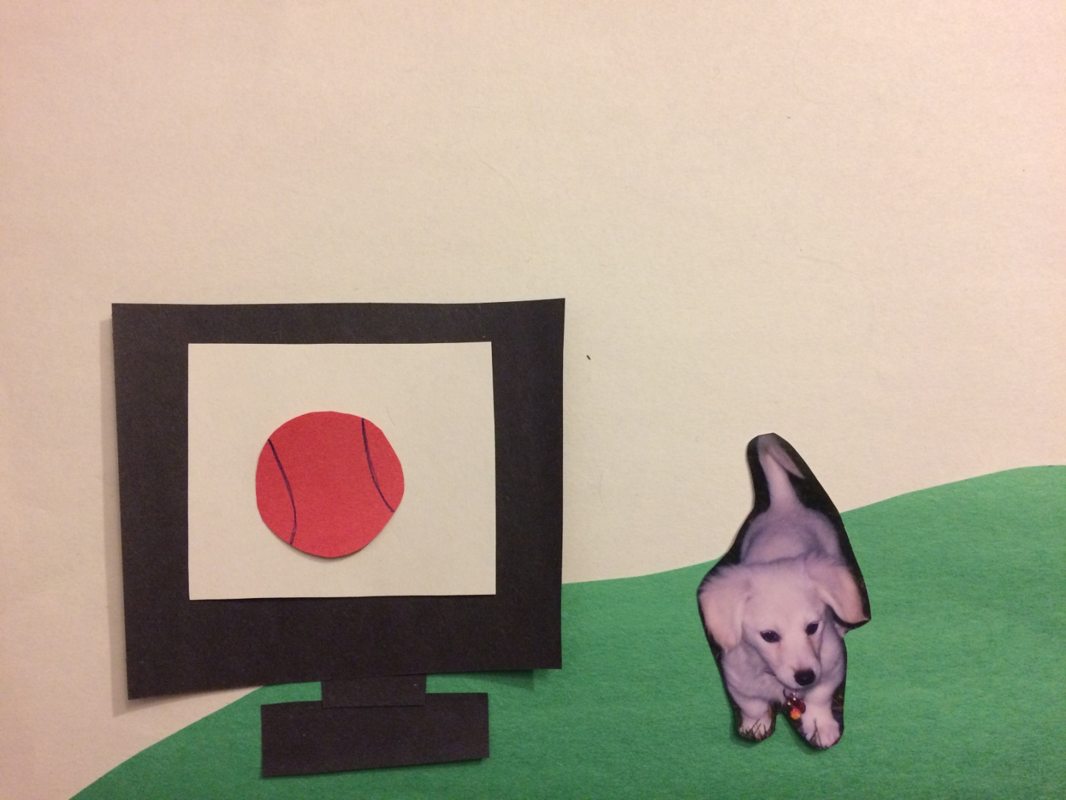
After each play date, Addy and her mommy watched the movie made during the play date.

Slide 14
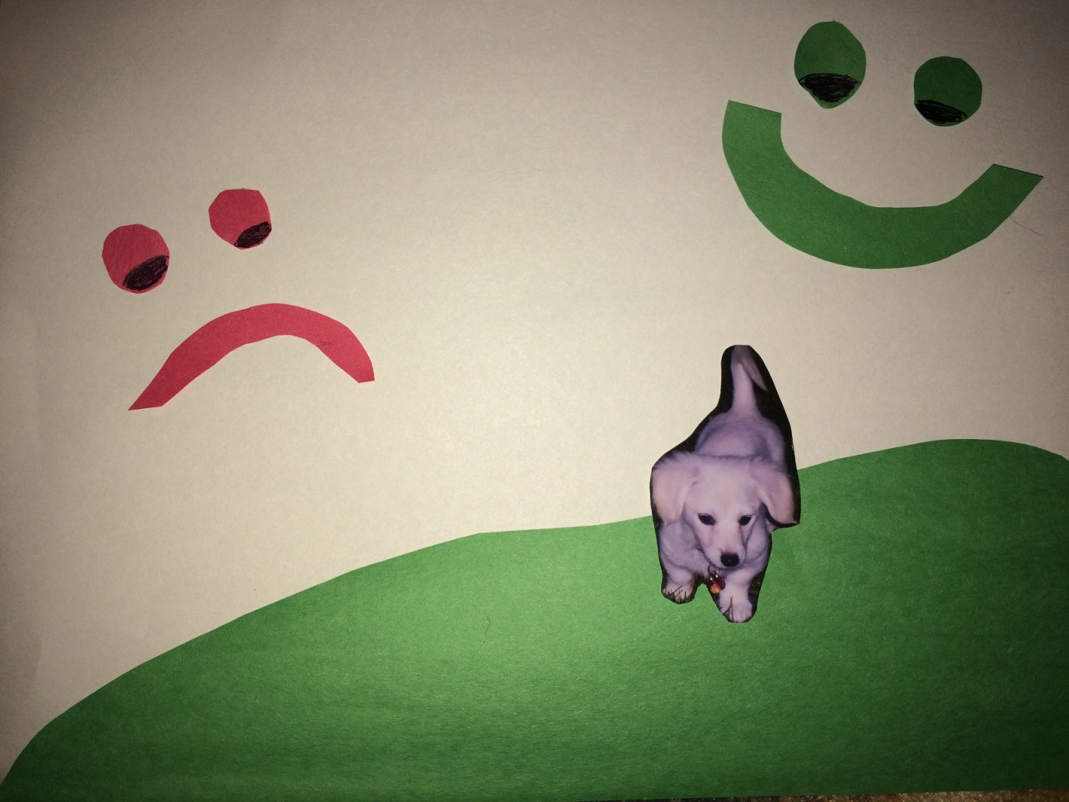
Addy and her mommy talked about if Addy let the other doggies come close without growling or biting. If she did, Addy pointed to a green happy face. If Addy growled and tried to bite the other doggies, she pointed to the red sad face. Each time Addy pointed to a green happy face, her mommy pet her and gave her a pupperoni!

Slide 15
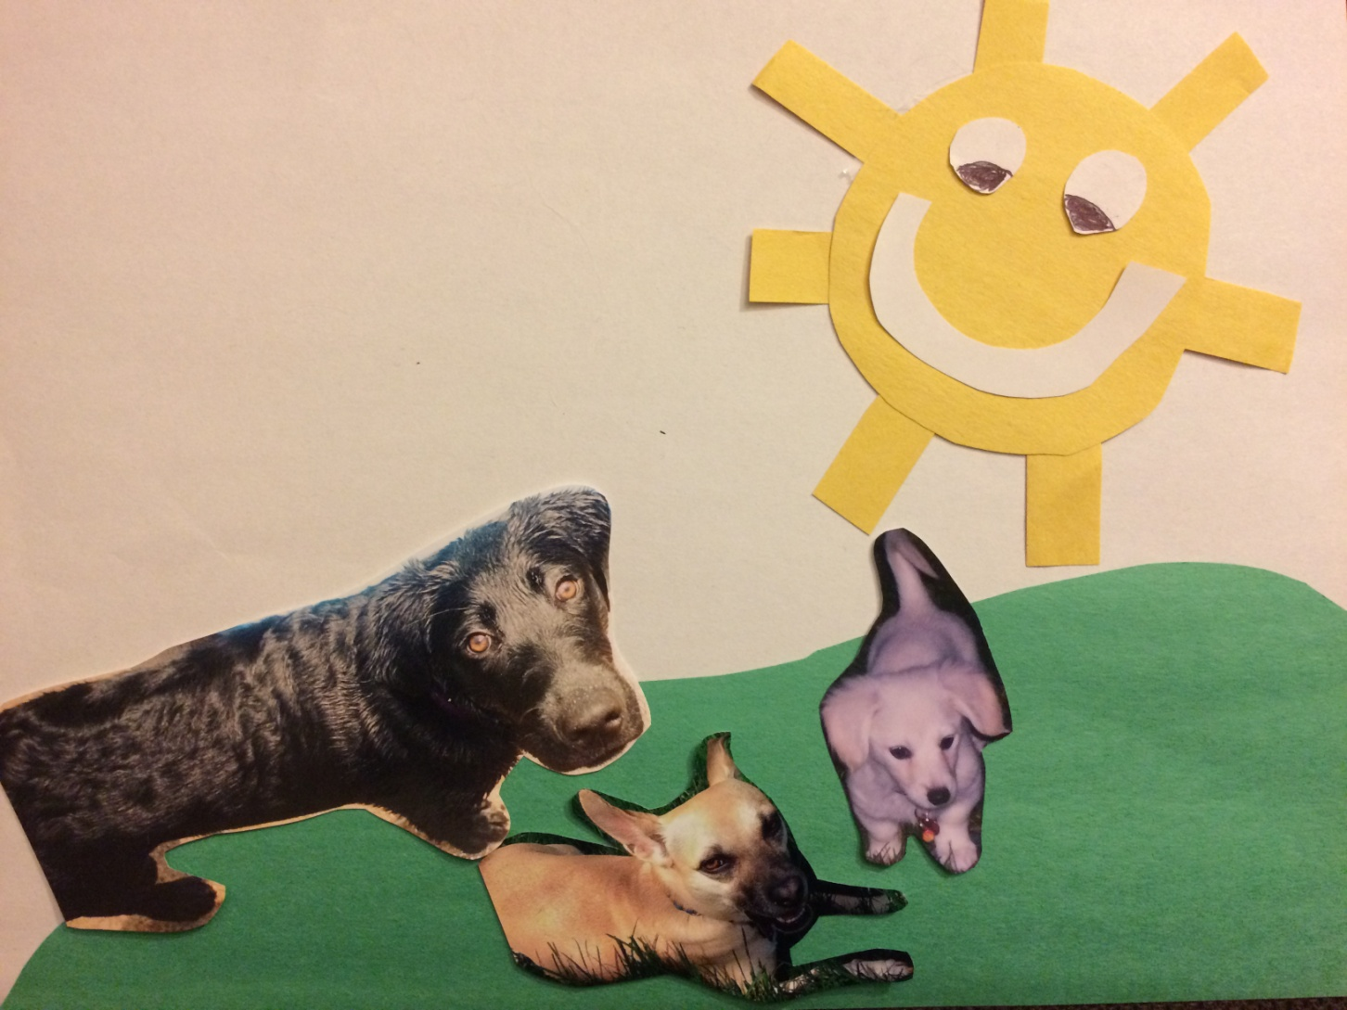
Each time Oscar and Spot came over to play, Addy started to play more! She began to understand that her friends did not like when she growled and bit them.

Slide 16
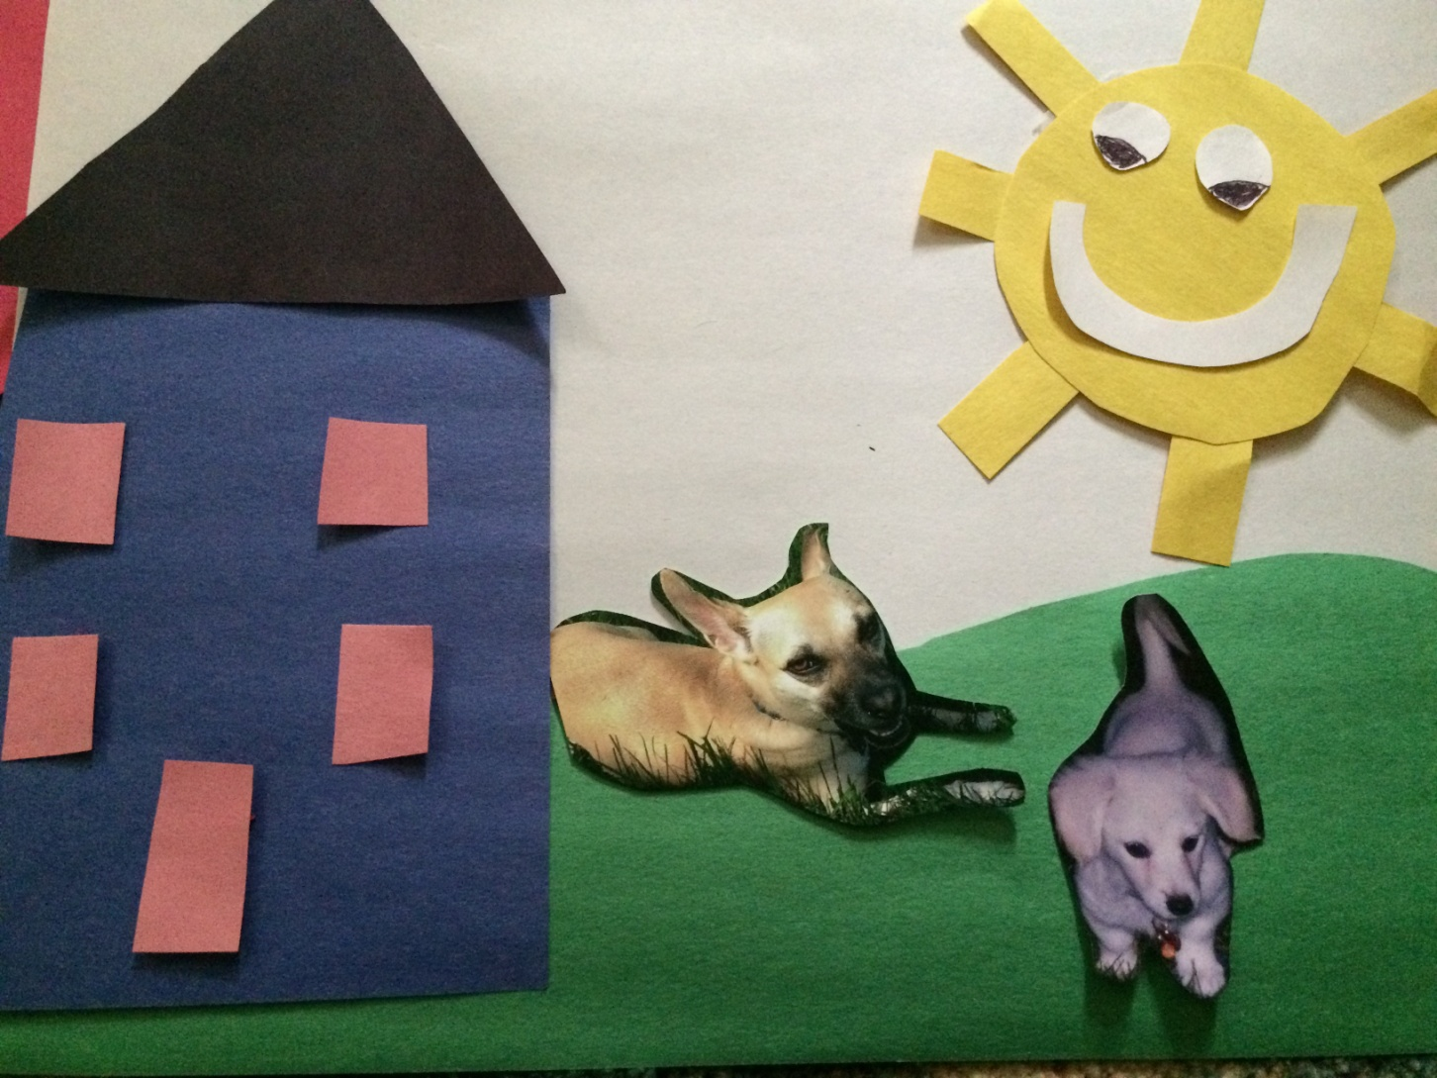
Addy and her mommy worked together to talk abut each play date. She used the faces to help her understand how to play nicely with her friends. After five play dates with Oscar and Spot, Addy went to Oscar’s house to play. She did not growl or bite Oscar anymore!

Slide 17
The End
Dear Reader,
I wrote this book because I want to help you understand video modeling. The book showed how video modeling could help children with playing with others. Video modeling can also be used to help children with communication and aggression while playing at school or at home. Video modeling can be used to help both young children and older children. You do not need any expensive equipment to make a video. You can use your smart phone; just make sure you are tapping the behavior that you want your child do. Videos do not need to be long. The video or videos just need to be long enough to show your child the behavior you want them to do, such as play. I hope you find this book helpful for understanding how to use video modeling. More information can be found at http://www.sbbh.pitt.edu.

