Slide 1
Principles of Behavior
A Guide for Parents
|
Meghan Swick
© 2011
The University of Pittsburgh

Slide 2
Section Title | Slide # | Section Title | Slide #
How Knowing Can Help | 3 | Rule Three: Withholding Consequences | 10
Words To Know | 4 | Rule Four: Punishment | 11
Rule One: Behavior Is Controlled By Consequences | 5 | Types of Punishment | 12
Behavior To Get Something | 6 | Rule Five: Consequences | 13
Behavior To Avoid Something | 7 | Rule Six: Modeling | 14
Rule Two: Behavior Is Strengthened By Reinforcement | 8 | Tips and Tricks | 15
Types of Rewards | 9 | FAQ and References | 16
Table
of Contents
Notes:
This presentation will cover all six rules of behavior. Each rule will be taught using real-life examples and easy to understand language. The presentation will also cover important words to know, tips and tricks and frequently asked questions

Slide 3
How Knowing Can Help
Understanding the rules of behavior helps parents see their child in a whole new way
Knowing the “why” behind a behavior helps parents understand how to change it

Slide 4
Words To Know
Antecedent: What happens right before the behavior
Behavior: An action or skill preformed by the child
Consequence: What happens right after the behavior or what the child gets for his action
Consistency: Providing the same consequence for the behavior every single time and in the same way for everyone
Modeling: Showing your child how you want her to act, by acting that way yourself
Reinforcement: The way others react to the child’s behavior – can be positive or negative
Punishment: The action of an adult used to decrease the child’s behavior
Research
Click For Print And Internet Resources!

Slide 5
Print Resources
Bear, D.M., Wolkf, M.M., & Risley, T.R. (1968). Some current dimensions of applied behavior analysis. Journal of Applied Behavior Analysis, 1, 91-97.
Matson, J., Benavidiz, D., Compton, L., Paclawskyj, T. & Baglio, C. (1996). Behavioral treatment of autistic persons: A review of research from 1980 to present. Research in Developmental Disabilities, 17, 433 - 465.
Sulzer-Azaroff, B. & Mayer, R. (1991). Behavior analysis for lasting change. Fort Worth, TX: Holt, Reinhart & Winston, Inc.
Internet Resources

Slide 6
Internet Resources
What is Behavior Analysis?
http://www.abainternational.org/ba.asp
Behavior Analysis Resources
http://psych.athabascau.ca/html/aupr/ba.shtml
Cambridge Center for Behavioral Studies
http://www.behavior.org/
Back to the Presentation

Slide 7
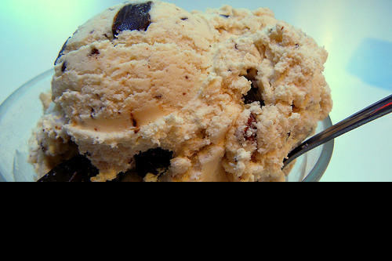
Rule One:
Behavior Is Controlled By Consequences
Domenic asks for a bowl of ice cream.
Mom says no
Domenic has a temper tantrum
Mom gives Domenic ice cream
What It Means.
The way a child behaves is caused by what he gets in return.
How It Works.
Behavior works in two ways:
1. To get something – attention, material, activity, food or sensory stimulation.
2. To avoid something – doing a task or social interactions.

Slide 8
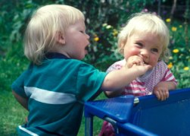
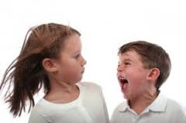
Attention
Try to: increase attention for appropriate behaviors, ignore problem behavior
Avoid: verbal reprimands, interruption
Material Activity Food
Try to: deny access, give access at times when the behavior is not occurring
Avoid: giving access after problem behavior
To Get Something
Sensory
Try to: interrupt/redirect behavior, give alternative stimulation
Avoid: ignoring behavior, giving a timeout

Slide 9
Completing A Task
Try to: reinforce doing task, teach how to seek help, make the task easier
Avoid: ignoring, timeout
Avoid Something
Social Attention
Try to: give reinforcement when social attention happens
Avoid: ignoring, timeout

Slide 10
Rule Two: Behavior Is Strengthened By Reinforcement
Riley picks up her toys
Riley gets a sticker
Riley gets a new toy
Riley earns five stickers
What It Means.
Behaviors will keep happening if they are
rewarded.
How It Works.
When children are rewarded with
something they like after a behavior,
they will repeat the behavior to be
rewarded again.

Slide 11
Types Of Rewards
Social
Expressed approval and praise
Comments: “Good job!” “I’m proud of you!”
Activity
Letting the child choose something she wants to do
Computer time, games, etc.
Tangible
Food
Toys
Token
Written: “Super”
Expressions: Smiling and clapping
Stickers
Awards
Points or tokens for behavior
Saved up and exchanged for something else

Slide 12
Rule Three: Behavior Is Weakened By Withholding Consequences
Daniel plays with his food at dinner time
His brothers laugh
His parents tell him to stop
Daniel continues to play with his food
What It Means.
Sometimes changing behavior means taking something away.
How It Works.
If you stop what happens after the negative behavior, while giving positive praise during a desired behavior. The behavior will change.

Slide 13
Rule Four: Behavior Is Weakened By Punishment
Lily calls her sister a name
Lily’s Mom immediately scolds her
Lily’s Mom tells her she will lose TV time that night
Lily stops calling her sister names
What It Means.
Punishment can mean giving a consequence or taking away a reinforcer.
How It Works.
Behavior disappears over time because of consistent consequences that the child does not like.

Slide 14
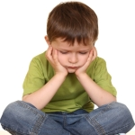
Types of Punishment
Giving a consequence immediately
Verbal reprimand
Taking away something the child likes
TV time
Computer/ video game privileges
Dessert or a special snack
Timeout

Slide 15
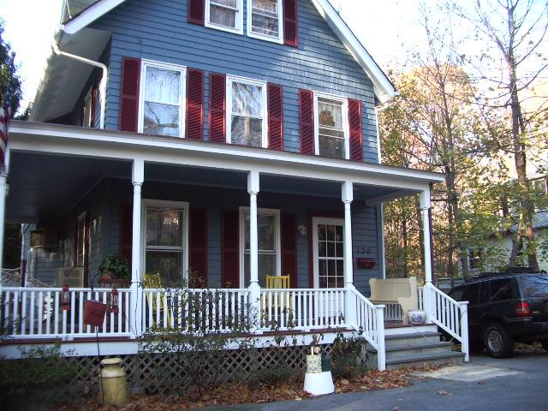
Rule Five: Consequences Must Consistently and Immediately Follow Behaviors
Sammy is not allowed to hit
Sammy hits in school
He gets a timeout
Sammy hits at home
Sammy hits at the park
Sammy is not given a punishment
He gets a timeout
What It Means.
Be consistent! The consequence must always be the same and applied to everyone, every time, everywhere.
How It Works.
Children learn to change their behavior only if what happens after that behavior is predictable and stays the same.

Slide 16
Rule Six: Modeling Teaches Behavior
What It Means.
Your child learns by watching you.
How It Works.
Children look to their parents to learn how to act, how to talk, how to play, and how to interact with their world.

Slide 17
Tips and Tricks
Remember…
Stay patient
Play to your child’s strengths
Be objective
Be realistic
Keep it simple
Get everyone on the same page
Celebrate the small victories
Don’t give up!

Slide 18
Frequently Asked Questions
Q: Can I really do this?
A: Yes! Just remember to keep it simple, and don’t give up. Start with the most minor behavior that you want to change and work your way up to the hardest.
Q: Will this really help?
A: Learning the rules of behavior help you to look and think about behavior in a different way. This will help you understand your child better, and make it easier to work on challenging behaviors.
Q: I’m trying but nothing seems to work. What am I doing wrong?
A: Remember that the behavior won’t change overnight. Try to remain objective. Take a step back and look at the situation again. Make sure you are being consistent, and that any consequences or rewards are meaningful to your individual child.

Slide 19
References
Dunlap, G., Newton, J. S., Fox, L., Benito, N., & Vaughn, B. (Winter 2001). Family involvement in functional
assessment and positive behavior support. Focus on Autism and Other Developmental
Disabilities, 16(4), 215-221. doi:10.1177/108835760101600403
Heiman, T. (2002). Parents of children with disabilities; resilience, coping and future expectations. Journal of
Developmental and Physical Disabilities, 14(2), 159-171.
Jull, S., & Mirenda, P. (2011). Parents as play date facilitators for preschoolers with autism. Journal of Positive
Behavior Interventions, 13(1), 17-30. doi:10.1177/1098300709358111
Kerr, M.M., & Nelson, C. M. (2010). Strategies for addressing behavior problems in the classroom, 6th Edition. Columbus, Ohio: Charles E. Merrill Publishing Company.
Ogletree, B. T., & Oren, T. (Summer 2001). Application of ABA principles to general communication
instruction. Focus on Autism and Other Developmental Disabilities, 16(2), 102-109.
doi:10.1177/108835760101600206
Park, J. H., Alber-Morgan, S. R., & Fleming, C. (2011). Collaborating with parents to implement behavioral
interventions for children with challenging behaviors. TEACHING Exceptional Children, 43(3), 22-
30.

Slide 20
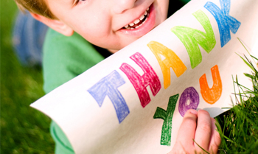
Meghan Swick
The University of Pittsburgh
© 2011

