Slide 1
Latency and Interval Recording for Parents
Click on speaker to hear narration.
Jennifer Wyse
University of Pittsburgh
Notes:
Thank you for taking the time to look over this presentation. Recording behaviors can seem like a scary and time consuming task. It is easy to assume that these methods are only for teachers, but they’re not! You can learn to use them, too! The following is a brief guide to latency and interval recording.

Slide 2
Outline
What is Positive Behavior Support and what does it mean to you?
Key Terms
An Introduction to Recording Behaviors
Understanding Latency Recording
Understanding Interval Recording
Frequently Asked Questions
References
Notes:
Before we begin, take a few moments and look over what we will be talking about during this presentation.

Slide 3
What is Positive Behavior Support?
A positive way of dealing with problem behaviors. ₍₅₎
PBS matches strategies with your child’s personal needs. ₍₅₎
Notes:
Positive Behavior Support, or PBS, is a positive way of dealing with problem behaviors that uses methods that research has shown to work (Kerr & Nelson, 2010, 6) With PBS, your child’s behaviors and needs are matched with methods that will help them. In order to do this, methods such as child, parent, and teacher interviews are given and information, or data, is collected by methods such as interval and latency recording. Recently, more school systems are adopting School-Wide Positive Behavioral Support, which allows PBS to be implemented throughout their entire schools (Kerr & Nelson, 2010, p. 6).

Slide 4
Can Parents be Involved in PBS?
Absolutely!
As a parent, you know things about your child that no one else does!
This information could help teachers and other professionals get to know your child and make a plan that works best.
Notes:
If your child goes to a school that uses School-Wide Positive Behavior Support, then you are probably already involved. If not, you can still get involved! As a parent, you have lived with and observed important information about your child. When schools and other agencies are working on making a plan that will help your child, your observations and input will give them a perspective that no one else can. This is a key beginning in the creation of a positive plan. In return, being a part of this process will give you information on how use these methods at home.

Slide 5
Key Terms
Baseline: How much and how often the behavior happens if we don’t stop it. ₍₅₎
Intervention: Plans that teachers and parents use to help kids get better. ₍₅₎
Latency: Latent is the root word for latency. Latent is a period of time that something is inactive, or not happening. Latency recording measures the amount of time a person is “inactive” or does not do what they are asked.
Notes:
Here are a few terms that may be helpful to you as you navigate through these slides. Baseline means how much and how often the behavior occurs if we don’t stop it (Kerr & Nelson, 2010). Intervention refers to plans that teachers and parents use to help kids get better (Kerr & Nelson, 2010). Latent is the root word for latency. Latent is a period of time that something is inactive, or not happening. Latency recording measures the amount of time a person is “inactive” or does not do what they are asked.

Slide 6
Recording Behaviors: An Introduction to Latency and Interval Recording
Recording behavior is done before, during, and after you have started doing something to help the behavior.
By using a behavior recording method, you will be able to:
Find a baseline for the problem behavior. ₍₆₎
Look and see if it gets better when you do something. ₍₆₎
Notes:
Now that you helped your child’s teacher understand more about him, it is time to find out some information on the behavior itself. One way of seeing whether or not the plan you have started is working is by using behavior recording. This is done before, during, and after you have begun intervention. The recording that is done before the intervention has started will tell us about the behavior before we have started any work. For instance, if the behavior we are working on with your child is hitting, our baseline data would be collected by observing how often your child is hitting at least three times before we begin our intervention. The information that we collect during those three observations will make up our baseline data. Later on, after we have started the intervention, more behavior recording will be done. This will show us whether or not the plan we created is working or not. Behavior recording is important for two reasons. First, to find the baseline data. And secondly, to help us watch whether or not the behavior is getting better after we have started our plan.

Slide 7
Recording Behaviors: An Introduction to Latency and Interval Recording
There are many different methods for recording data. Here we will focus on
Interval Recording
and
Latency Recording
Choosing the recording method that is right for you will depend on the behavior that you want to observe.
Notes:
There are a variety of ways to record behaviors. For this presentation, we will focus on two useful methods: interval recording and latency recording. Each method works best for certain types of behavior. Choosing the recording technique that will work best for will depend on the behavior that you would like to observe. Let’s look at these two different methods separately.

Slide 8
Jack: A Case Study
Notes:
It’s Thursday evening in Jack’s house, and once again, Jack’s mom is asking him to do his reading homework. Much like every other night, he refuses to do so. An eight year old boy half way through his second grade year, Jack has refused to respond to his mom’s requests to do his homework for the last month. “Jack, you’re almost done. Please finish so you can get to bed on time tonight.” Jack rolls his eyes, puts his head in his hand, and shoves his paper away. “Jack. I mean it. Start working.” His mom is starting to get frustrated now. Jack turns around in his chair, leaving his reading book unattended to on the table. “It’s stupid. I’m not doing it.” Eventually, after a lot of arguing and pleading, Jack picks up his pencil and scribbles some answers down on his paper. That night, after Jack goes to bed, Jack’s mom wonders to herself, again, “Why is Jack refusing to do his reading work? I want to help, but where do I begin? ”

Slide 9
Latency Recording
Counting how long it takes your child to do something you ask. ₍₆₎
Notes:
Jack’s mom wants to record how long it takes him to respond to her when she asks him to do his reading homework. This is a good example of one that could be measured with latency recording. Latency recording is simply a behavior measurement method that measures how long it takes a child to do what he is asked to do (Maag, 2004). In Jack’s case, his mom could have started a timer when she first asked Jack to start his homework. When Jack picked up his pencil and began his work the timer is stopped. The time that is shown is the response latency.

Slide 10
Latency Recording: What it Looks Like
Date | I Ask | Child Did It | Latency/ How Long
Notes:
Recording response latency is a straight forward method of behavior recording. However, it is important to keep your findings organized. Here is an example of a chart layout commonly used to record latency data. When you begin recording, write the date, the time that you asked your child to do something, the time that your child did it, and then subtract those two numbers to find your latency. After you have done several observations, you will be able to see whether the behavior has gotten better, worse, or stayed the same by looking at the latency times that you wrote in the last columns. For a detailed guideline of steps for this chart, as well as a completed version, you can turn to the study guide that accompanies this presentation.

Slide 11
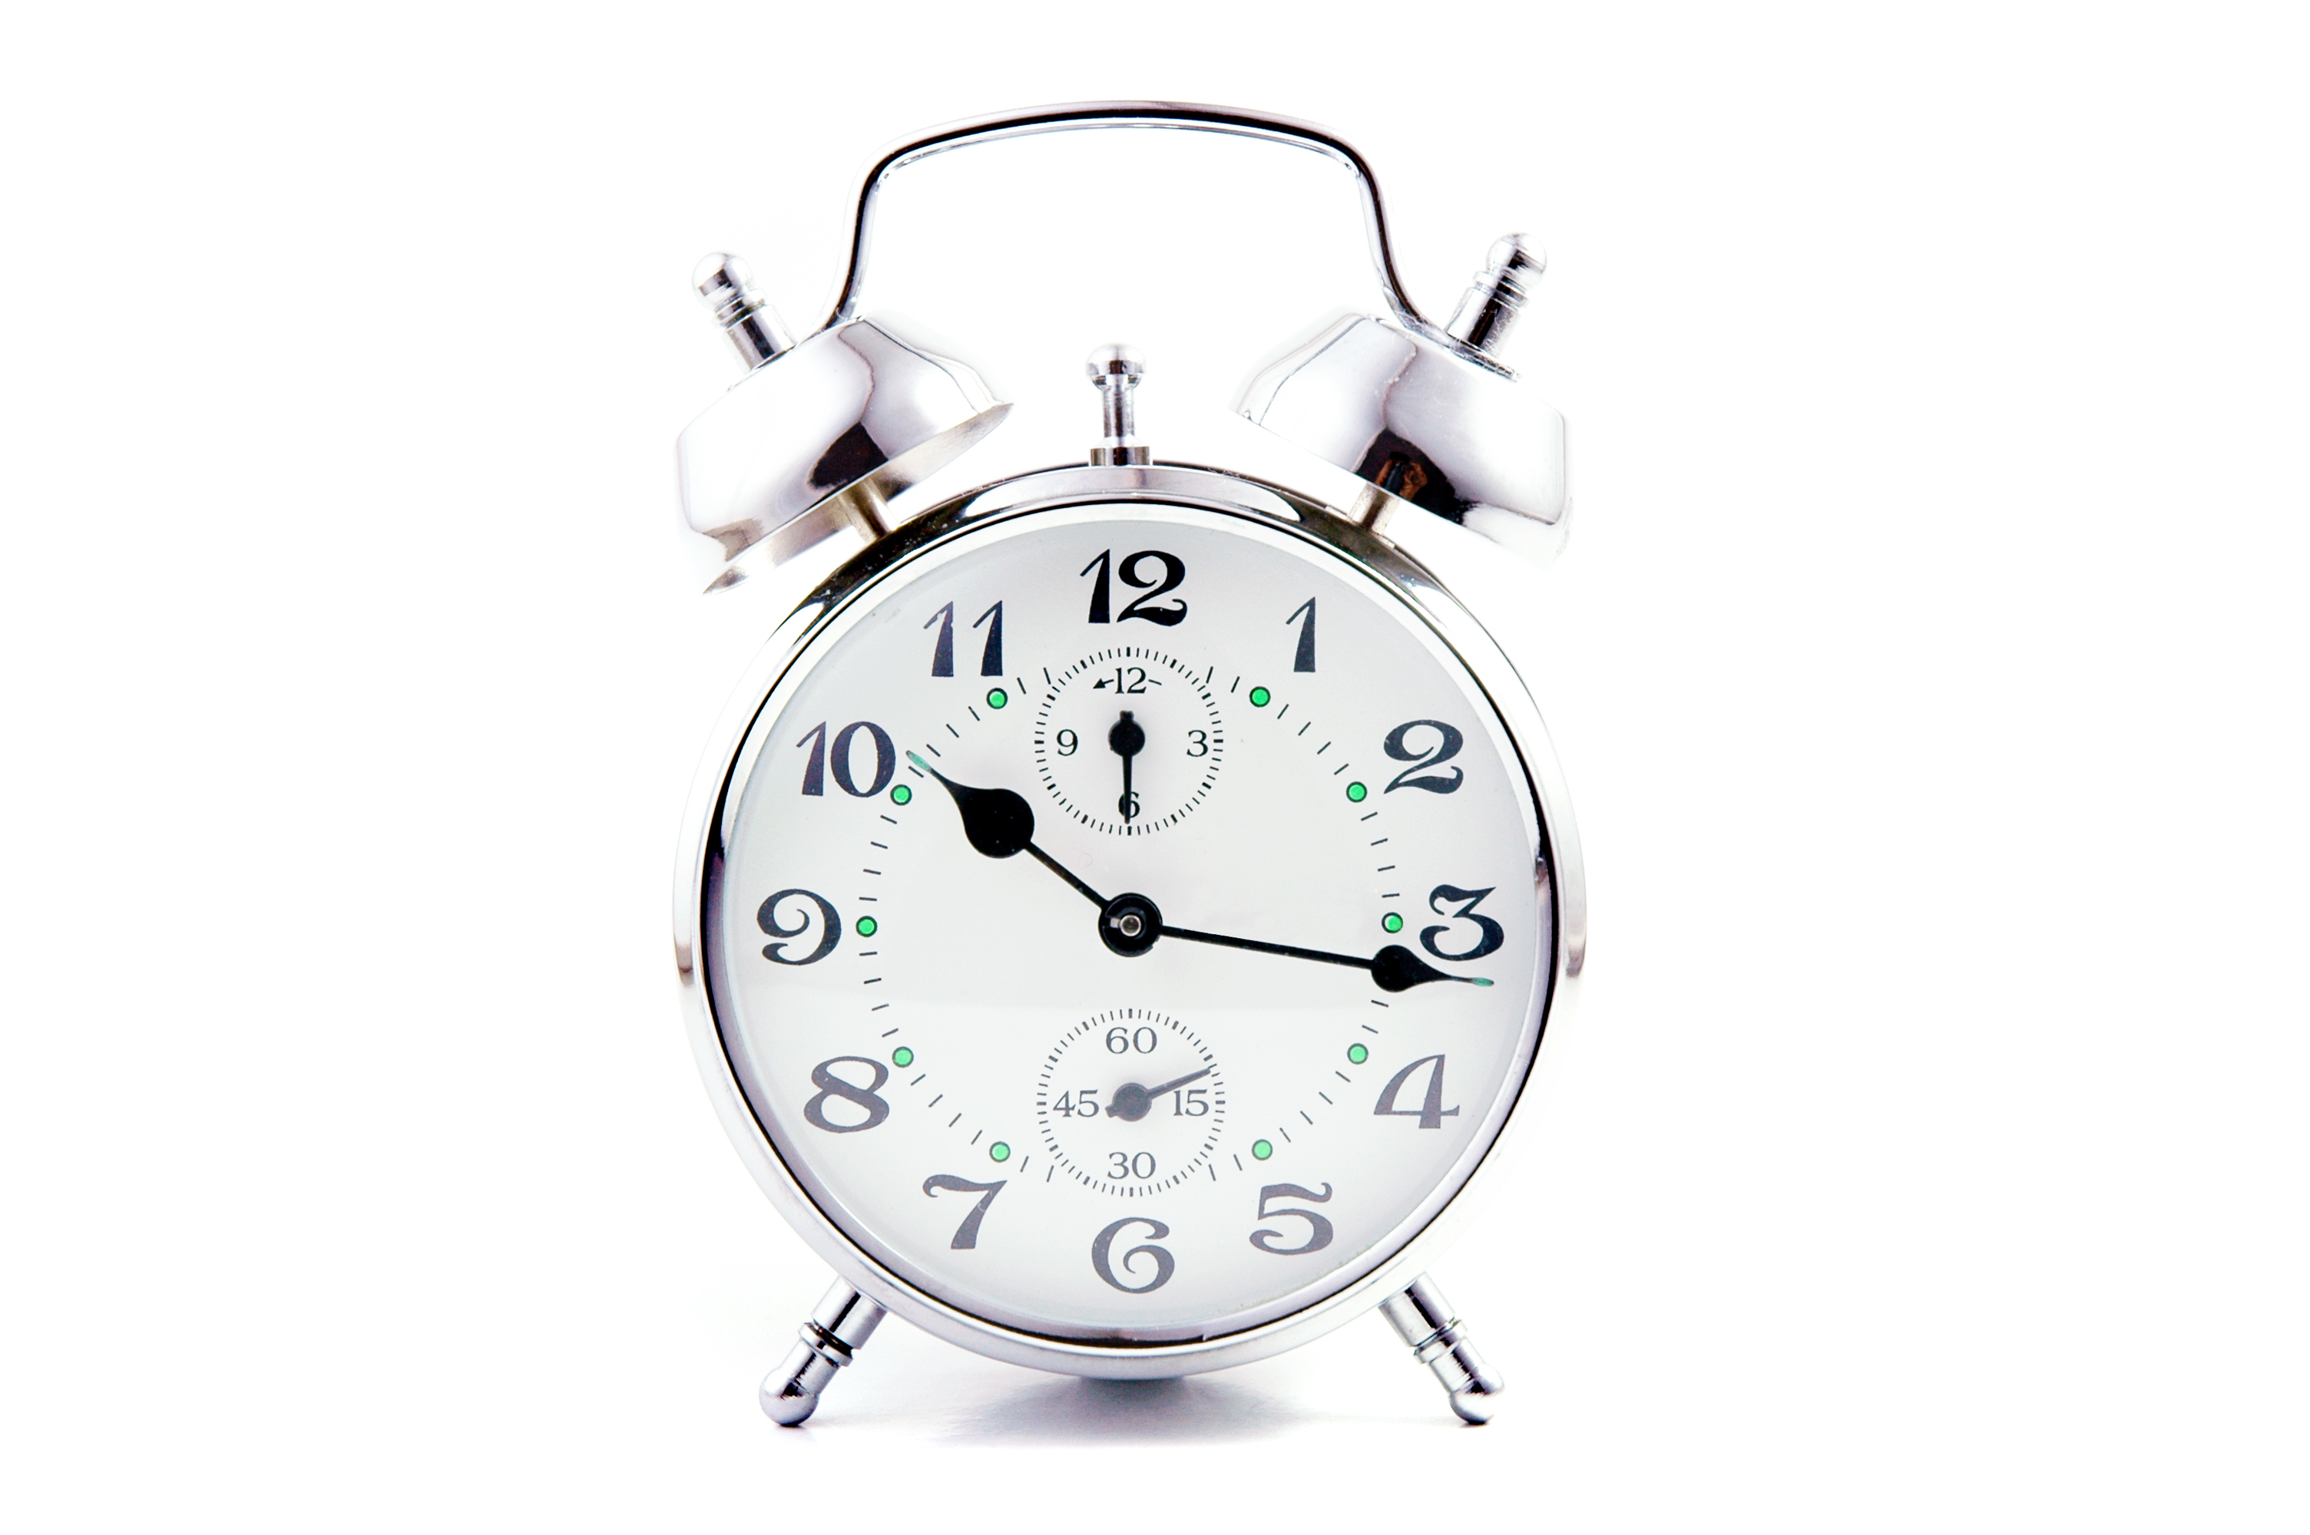
Latency Recording
Do
Don’t
Record often.
Involve your child.
Talk to your child’s teacher about what you find.
Don’t become overwhelmed!
Don’t be afraid of allowing your child to know that you are recording behavior.
Don’t feel like you are alone in this process! Working with teachers and other professionals will be help both you and them. It’s a team effort!
Notes:
Here is a list of some basic do’s and don’ts that may help you when you are going to begin latency recording. First, record your child’s behavior often. Find a time in the day that you know you’ll be able to take a couple of minutes to record behavior. For Jack’s mom, every night when she is going to ask Jack to do his homework, she will also have her timer ready. It is also okay to involve your child in this process. Letting him know that you are beginning to record how long it takes him to follow a direction will get him involved. He may even want to know whether or not his time is getting better! Finally, if your child is showing these same behaviors in other places, such as school, it is a good idea to let your child’s teacher know what you are finding out about the latency response. Giving teachers feedback, as well as getting it yourself, will be helpful in this intervention process.

Slide 12
Monica: A Case Study
Notes:
Monica is a kindergarten student who has spent the majority of her year expressing her anger through hitting. In school, Monica has hit her teachers and her classmates. Monica’s teacher, frustrated about this behavior, contacted her dad asking if she was engaging in the same behavior at home. First, the two discussed when they most often saw these behaviors. They also discussed how it effects Monica and the people around her in either environment. Ms. Welton then gave Monica’s dad some time to discuss any other observations he had made. Ms. Welton suggested using interval recording to record and monitor Monica’s hitting at both home and school. This will help to understand how serious and frequent the hitting has become. Slightly embarrassed, but glad to have a new plan of action, Monica’s dad got off the phone with Ms. Welton with a plan he was ready to put into action.

Slide 13
Interval Recording
A paper with boxes that you mark. The marks show how often a behavior happens ₍₅₎
Notes:
Interval recording is a paper with boxes that you mark. The marks show how often a behavior happens (Kerr & Nelson, 2010, p. 152). Behaviors that you will record using interval recording happen a lot and happen fast. Monica is a good example of a child who could benefit from interval recording. Her hitting is happening a lot, and it’s something that is fast and could be hard to count, so her dad could use interval recording. When using interval recording a period of time is divided up into shorter blocks of time, typically between 5-30 seconds longs. For instance, if you are observing your child for a total of five minutes a day, you would divide that five minutes up in to 30 second intervals. During the time that you are observing, for each time your child hits, you will put an X in the box for that thirty seconds.

Slide 14
Interval Recording: What It Looks Like
Interval # | 1 | 2 | 3 | 4 | 5 | 6 | Total X
X or O
Interval # | 1 | 2 | 3 | 4 | 5 | 6 | Total X
X or 0
Interval # | 1 | 2 | 3 | 4 | 5 | 6 | Total X
X or O
Interval # | 1 | 2 | 3 | 4 | 5 | 6 | Total X
X or O
Interval # | 1 | 2 | 3 | 4 | 5 | 6 | Total X
X or O
Notes:
Here is an example of an interval recording form. If we were recording for a total length of 1 minute at a time, we could divide our intervals up into 10 second time periods. For this table, each row represents a one minute observational time. Each number, 1-6, represents ten seconds within that minute. For each interval during that minute, if the behavior I am observing occurs within a given interval, I would mark an “X” within that interval. If the behavior does not occur during that interval, I would record an “O”. At the end of each minute, I am easily able to count the number of “X” marks for that observation. This may seem like a lot of information, but don’t worry! For details on this table, please see the study guide that goes with this presentation. There you will find this chart with a few simple steps that will help you do interval recording at home as well as a completed version of this chart.

Slide 15
Interval Recording
Do
Don’t
Use short intervals to record behavior.
Use a stopwatch or another watch you can easily read.
Use interval recording for behaviors that occur often and quickly such as: hitting, talking out, hand flapping, and getting up out of seat.
Don’t choose intervals or boxes that are too long.
Try to keep track of time without a watch.
Notes:
There are a few key things to remember when using interval recording. First, remember to use short intervals. Consider the behavior you are recording, if it is a behavior such as yelling out, and the yelling generally lasts more than 10 seconds long at a time, it would be appropriate to use 15 second intervals (Kerr & Nelson, 2010, p. 152). Secondly, because interval recording’s accuracy is dependent on keeping track of your interval times, it is a good idea to have an easily readable stopwatch or watch to use. Trying to count seconds on your own without a watch will only make this recording difficult and inaccurate.

Slide 16
Frequently Asked Questions
Q: Is my child an appropriate age to do interval or latency recording?
A: Simply put, yes. Recording behaviors are simply a part of the intervention process that will help you and other professionals to monitor effectiveness. Recording behavior can help you understand behavior at any age.
Q: How do I know when to use interval recording versus latency recording?
A: The type of observational method that you will use will depend on the behavior your want to observe. If it is a behavior that occurs frequently and you want to see how often the behavior is happening, interval recording will be an effective choice. If you are measuring a behavior that requires a measurement of time lapse, like following directions, the best choice would be latency recording.
Notes:
Now take a few moments to look over frequently asked questions about interval and latency recording.

Slide 17
References
Alberto, P. A., & Troutman, A. C. (2006). Procedures for collecting data. In Applied behavior analysis for teachers (7th ed., pp. 53-93). Columbus, Ohio: Pearson Prentice Hall.
Filter, K. J., & Horner, R. H. (2009). Function-based academic intervention for problem behavior. Education and Treatment of Children, 32(1), 1-19.
Heiman, T. (2002). Parents of children with disabilities: Resilience, coping, and future expectations. Journal of Developmental and Physical Disabilities, 14(2), 159-171.
Jull, S., & Mirenda, P. (2011). Parents as play date facilitators for preschoolers with autism. Journal of Positive Behavior Interventions, 13(1), 17-14. doi:10.1177/1098300709358111

Slide 18
References
Kerr, M. M., & Nelson, C. M. (2010). Monitoring student progress. In Strategies for addressing behavior problems in the classroom (6th ed., pp. 136-163). Upper Saddle River, New Jersey: Pearson Education, Inc.
Maag, J. W. (2004). Counting and recording behavior. In Behavior management: From theoretical implications to practical applications (2nd ed., pp. 93-123). Belmont, CA: Thomson Learning, Inc.
Pabico, R. S., Call, N. A., & Lomas, J. E. (2009). Use of latency to problem behavior to evaluate demands for inclusion in functional analyses. Journal of Applied Behavior Analysis, 42(3), 723.
Park, J. H., Alber-Morgan, S. R., & Fleming, C. (2011). Collaborating with parents to implement behavioral interventions for children with challenging behaviors. Council for Exceptional Children, 43(3), 22-9.

