Slide 1
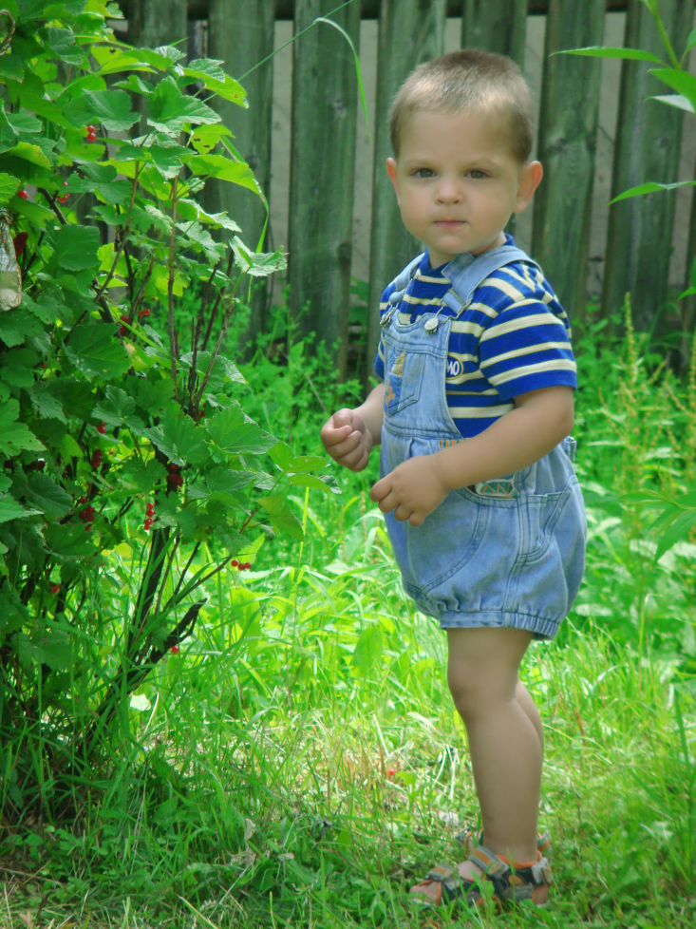
Research on Challenging Behavior in Young Children: What Teachers Should Know
Vanessa Shrontz
University of Pittsburgh
April 2010
Permission granted
Notes:
This presentation is for teachers to learn more about the research on challenging behavior in young children.

Slide 2
Agenda
Introduction
Glossary of Terms
Summary of Research
Case Study
Key Concepts
Do’s & Don’ts
FAQs
References
Permission granted
Notes:
This slide is a overview of the main components of this presentation.

Slide 3
Intro
Challenging behavior in young children is a problem for many teachers
Research-based practices, effective interventions and teaching strategies are available
Techniques based on many PBIS concepts
Universal prevention
Teaching pyramid
Positive reinforcement
Notes:
Challenging behavior in young children can be a major concern for teachers. Many research-based strategies exist for reducing challenging behavior. These techniques rely on several Positive Behavioral Interventions and Supports or PBIS concepts. This presentation will explain key features of effective interventions and practical implementations for teachers to use in their classrooms.

Slide 4
What is Challenging Behavior ?
Challenging Behavior is any behavior that:
interferes with the child’s optimal development, learning, or play.
inhibits prosocial behavior.
is harmful to the child and others around them.
(Dunlap et al., 2006)
Notes:
Challenging behavior is considered to be any behavior that impedes a child’s development, interferes with prosocial behavior, or harms the child and those around them. This behavior is typically excessive and not age-appropriate.

Slide 5
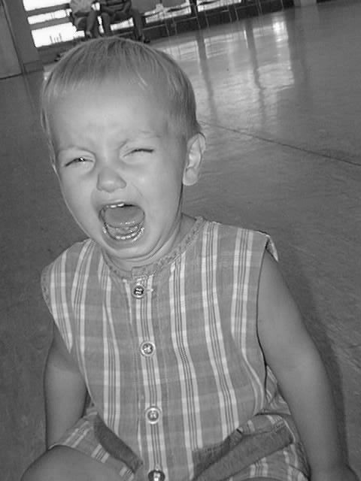
What is Challenging Behavior?
Examples:
Aggression: hitting, spitting, biting, destroying objects, bullying (Kaiser & Rasminsky, 2007)
Disruptive behavior (Dunlap et al., 2003)
Defiance or noncompliance (Dunlap et al., 2003)
Permission granted
Notes:
Challenging behavior is different in every child; it can vary from hitting and kicking to defiance of rules and authority.

Slide 6
Glossary
Antecedent: an action, behavior, or stimulus that occurs before a behavior (Kerr & Nelson, 2010)
Challenging behavior: any consistent behavior that inhibits a child’s development, prosocial behavior, or is harmful to the child (Dunlap et al., 2003)
Consequence: an action, behavior, or stimulus that occurs after a behavior (Kerr & Nelson, 2010)
Notes:
To fully understand the best practices for reducing challenging behavior in young children, you must first understand a few key terms. Take a few minutes to review the next few slides.

Slide 7
Glossary
Functional Behavior Analysis (FBA): a process used to identify the functions a maladaptive behavior serves, includes observations, interviews, and developmental tools (Kerr & Nelson, 2010)
Positive Behavioral Interventions and Supports (PBIS): a system that supports and promotes positive behavior in children in all settings: utilizes primary, secondary, and tertiary prevention (Kerr & Nelson, 2010)

Slide 8
Glossary
Replacement behaviors: appropriate behaviors used to replace challenging behavior (Kaiser & Rasminsky, 2007)
Teaching pyramid: a teaching model proven effective in reducing challenging behavior in young children; promotes positive relationships, classroom practices, social and emotional skills, and individual interventions (Fox, Dunlap, Hemmeter, Joseph, & Strain, 2003)

Slide 9
Glossary
Universal prevention: a system used with all students as a preventative and protective strategy (Kerr & Nelson, 2010)

Slide 10
Research
Approximately 3-15% of young children over the age of 3 display challenging behavior (Kaiser & Rasminsky, 2007)
Unidentified and untreated challenging behavior has negative and long-lasting impacts on children’s futures (Dunlap et al., 2003)
Quality care and good interactions can reduce challenging behavior (Dunlap et al., 2003)
Notes:
This slide highlights a few important research findings in the field. Challenging behavior is a frequent problem in classrooms. When these behaviors are not addressed and treated they can have a major impact on children’s development. Challenging behavior can be reduced through quality care and positive interactions.

Slide 11
Causes: Risk Factors
Biological
Genes: just because a child inherits a specific trait (eg. aggression) does not mean they will exhibit it
Temperament
Many behaviors associated with ADHD are also considered challenging behaviors
Prenatal care: alcohol or substance exposure
(Kaiser & Rasminsky, 2007)
Notes:
There is no one cause of challenging behavior. Children who have more than one risk factor, biological or environmental, have an increased risk of exhibiting challenging behavior.

Slide 12
Causes: Risk Factors
Environmental
Family factors
Parenting styles
Poverty
Exposure to violence
(Kaiser & Rasminsky, 2007)
Notes:
This slide looks at the environmental risk factors that can increase challenging behavior.

Slide 13
Places/Settings/Situations
Practices are designed for young children ages 3-5 years old
Strategies are for a school or early childhood center setting
Techniques are intended for young children with challenging behaviors
Notes:
The techniques and practices discussed in this presentation are intended for young children with challenging behavior ages three to five in a school setting. Many of the strategies are effective for older children as well. Some of the strategies, universal prevention, teaching strategies, and tips on classroom environments can be beneficial for all children, not just children with challenging behavior.

Slide 14
Teaching Pyramid
Intensive Individualized Treatments
Social Emotional Teaching Strategies
Social Emotional Teaching Strategies
Positive Relationships with Children, Families, and Colleagues
(Based on Fox et al., 2003)
Notes:
This is the Teaching Pyramid, it promotes social competence and is an effective intervention in reducing challenging behavior in young children. This model is closely related to the PBIS pyramid. The first level focuses on building strong relationships. A positive teacher-child relationship is extremely important in reducing challenging behavior. The next level looks at a supportive and caring school environment. Social and emotional teaching strategies are on the next level of the pyramid. The top level focuses on providing individual interventions to the children that need additional support in reducing challenging behavior.
This figure is in one of my articles, is it ok to use it? I can also create my own pyramid.

Slide 15
Case Study
Miranda is a 4 year-old girl
Aggressive, disruptive, and constantly on the move
hits, bits, and kicks her classmates and teachers
severe tantrums
structured activities: yells, leaves areas, and makes herself the center of attention
destroys toys and other children's work
Similar behaviors at home
Parents and teachers at a loss of what to do with her.
Permission granted
Notes:
The following case study presents Miranda, a 4 year-old girl with challenging behavior. Her behavior interferes with her development and daily activities. She puts herself and those around her in danger. Please take a few moments to review the case study. It will be revisited later in the presentation.

Slide 16
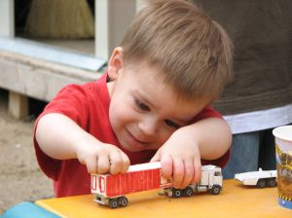
Qualities of Effective Interventions
Developed from FBAs
Looks at antecedent and consequence of behavior
Identifies link between the child’s challenging behavior and environment
Intervention will address function of behavior
(Dunlap et al., 2006)
Permission granted
Notes:
The information presented in this and the next few slides discuss the qualities that make an intervention for reducing challenging behavior in young children effective. By conducting a FBA, teachers can identify the antecedent and consequence of a behavior. All behaviors serve a function, positive or negative. Replacement behaviors can fulfill that same function in a beneficial way.

Slide 17
Qualities of Effective Interventions
Many children with challenging behavior have delayed social and language skills
Teaching procedures
Replacement skills
Reduce reoccurrence of challenging behavior
Self-management skills
Increase appropriate behavior
Peer-related social skills
(Dunlap et al., 2006)
Notes:
Many teaching strategies are effective at reducing challenging behavior. Some children with challenging behavior lack social and language skills, it is important to help these children express their needs and feelings in appropriate ways. Teaching children replacement behaviors in place of their challenging behavior is one of the most effective strategies.

Slide 18
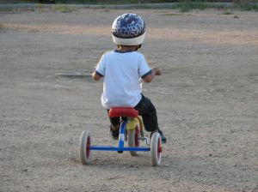
Qualities of Effective Interventions
Alterations to activities, social and physical environments
Change classroom environment
Rearrange instructions, schedule, classroom layout
Increase the chance appropriate behavior will occur
Allow choice in daily schedule
(Dunlap et al., 2006)
Permission granted
Notes:
Making alterations to the classroom are also effective in reducing challenging behavior. The physical layout of the room may encourage children to be aggressive in certain areas. Rearranging the schedule to fit all of the children’s needs may be beneficial. Allowing choice in activities often removes a power struggle and keeps children interested.

Slide 19
Qualities of Effective Interventions
Consists of many components
Antecedent interventions
Decrease likelihood of challenging behavior
Increase prosocial behavior
Consequence interventions
Decrease challenging behavior itself
Implemented in multiple locations
(Dunlap et al., 2006)
Notes:
Multicompenent interventions are effective. These interventions include several strategies, such as antecedent and consequence interventions. An antecedent is a stimulus that occurs before a behavior and a consequence is a stimulus that occurs after a behavior. Interventions addressing either would alter or replace the stimulus. Teachers may alter the daily schedule, rearrange the classroom, and modify the way they direct and speak to children.

Slide 20
Qualities of Effective Interventions
Involve the family in planning and implementation of interventions
Families significantly impact children’s development
Providing families with techniques provides children with consistent behavior expectations
Involving families produces long-lasting durable reductions in challenging behavior
(Dunlap et al., 2006)
Notes:
Family involvement is essential in reducing problem behavior. Families influence children’s development and behavior. Including parents in the planning and implementing process creates stability for the child in expectations at home and school. Family involvement produces longer-lasting and durable effects.

Slide 21
Relationships
Best tool for a teacher
Strong relationships make children feel safe, free to explore, and builds self confidence
Form a secure attachment by being sensitive, prompt, and consistent
Helps reduce challenging behaviors
(Kaiser & Rasminsky, 2007)
Notes:
Strong teacher-child relationships are key in reducing challenging behavior. When a child trusts their teacher positive behaviors and prosocial actions will most likely increase. Forming a secure attachment with a child who presents challenging behavior can be difficult. Often children have an unsecure attachment with their primary caregiver. Teachers are usually the first relationship a child forms with an adult outside of their family. This relationship can influence the child’s future relationships with teachers, academic attitude, and outcomes.

Slide 22
relationships
Be cautious of your speech and directions towards children with challenging behavior
Children who are perceived as problem children often receive more commands
Permission granted
(Dobbs & Arnold, 2009)
Notes:
Teachers speak to children perceived as having behavior problems differently than children perceived as well behaved. This may unconscious and unintended but it does occur. Children with challenging behavior receive more commands instead of questions, prompts, and requests. Commands limit a child’s exploration and curiosity about the world.

Slide 23
Classroom Practices
Routine
Varied activities create a balanced day
Adjust to fit children’s needs and interests
Adjust activities to level of child
If too demanding or difficult a child will become frustrated and escape from the situation
Offer choice
Free time and open-ended materials support prosocial behavior and healthy interactions
Materials
Encourage social interactions
Tactile experiences
(Kaiser & Rasminsky, 2007)
Notes:
By assessing and adjusting classroom practices challenging behavior can be decreased and prosocial behavior can be increased. Routine, materials, and time for child choice are important classroom areas to evaluate and modify.

Slide 24
Classroom Environment: Physical
Plan so children can move freely
Place toys at children’s level
Wide open space
Room to move but not enough to run and be wild
Centers
Areas in logical location (eg. art activity near sink)
Permission granted
(Kaiser & Rasminsky, 2007)
Notes:
The physical environment of a classroom can impact children’s behavior. The classroom should be set up to support play and learning and reduce potential problems.

Slide 25
Classroom Environment: Social
Create positive social climate
Model acceptable behaviors and attitudes
Teachers are role models
Children learn constantly by observing and imitating teachers words, actions, and body language
Teaching prosocial behaviors and problem solving skills
Repetition, observation, and practice
Games, group activities, cooperative play
Encourage peer support and compliments
(Kaiser & Rasminsky, 2007)
Notes:
The social environment also impacts behavior. Remember as a teacher, your behavior and attitude has a significant impact on the classroom environment. Children are always observing and modeling adult behavior.

Slide 26
Teaching Strategies
Emotional literacy
Teach children feeling words and how to identify emotions
Anger and impulse control
Teach children to recognize anger and use replacement behaviors
Problem solving
Recognizing problem and use alternative solution
Friendship skills
Taking turns, sharing, negotiating
(Fox et al., 2003)
Notes:
Teaching children social and emotional strategies can be trying. The end result, however, will be a reduction in challenging behavior. Using these techniques will help children identify and deal with their emotions in a productive manner.

Slide 27
Guidance and Redirection
Some children with challenging behavior need additional support and guidance
Positive Reinforcement
Verbal, physical, social, or tangible
Most effect when given immediately, consistently, and describes the positive action
Encouragement
Recognize child’s effort and improvements not the end product
(Kaiser & Rasminsky, 2007)
Notes:
Altering teaching strategies, classroom environment, and classroom practices are the best first steps in reducing challenging behavior. Often, however, children need additional help. Positive reinforcement and encouragement are two commonly used strategies. These strategies take no additional time in the day, just modifying your own language and behavior towards children.

Slide 28
Guidance and Discipline
Time away: redirection, teach anger and impulse control
Time out creates more challenging behavior
Hitting, screaming, refusing to sit in designated spot
Time away allows a child to take a break from an activity and return when they are ready
One minute for each year of age
Eg. Five minutes for a
for a five-year old
(Kaiser & Rasminsky, 2007)
Notes:
Time out often escalates challenging behavior. Time away allows a child to leave an activity, calm down, and return when they are ready. Children can be taught impulse control during this time away. When time away is first implemented the child may need the teachers assistance to leave an activity and regain control. During time away a teacher can discuss the problem and possible choices with the child.

Slide 29
Shared Concern
Parents are equally as frustrated, they struggle:
obtaining accurate useful information .
receiving services and support.
financially.
Parents often feel isolated from family members and the community
Teachers can be a good contact, source of information, and advocate for the child and parents
(Worcester, Nesman, Mendez, & Keller, 2008)
Notes:
Know that you are not alone. Parents are equally as frustrated and confused about how to reduce challenging behavior. They not only have to teach the child like you do, but they have additional stressors.

Slide 30
Do’s
Build a strong relationship with the child
Create a welcoming classroom environment
Be cautious of your language you use with children, be careful with commands
Involve the family, they are concerned like you
Become a useful resource to the family
Be patient! This can be a complicated process but a beneficial one if you use effective strategies.
Notes:
This slide highlights the important steps for teachers to keep in mind and use with young children with challenging behavior.

Slide 31
Don’ts
Ignore the child, the behaviors will not go away on their own
Be unwilling to change your classroom structure and environment because it works for most of the children
Exclude the child’s family from the intervention process
Don’t give up! This is a complicated process and can take time
Notes:
These points teachers should avoid when interacting with young children with challenging behavior.

Slide 32
Case Study
Miranda’s teachers conduct a FBA
Identify relationships between behavior and environment
Parents are included in intervention planning
Give insight on behavior and schedule at home and interests
Effort to build a relationship
Greet her each morning with enthusiasm and warmth
Makes her excited to be at school
Permission granted
Notes:
Think back to Miranda’s case study. Lets look at her behavior after her teachers implemented some key concepts discussed in this presentation to reduce her challenging behavior. The Case Study continues onto the next slide.

Slide 33
Case Study
Replacement behaviors
Stomps feet or throws a soft ball at the wall instead of hitting or biting
Warnings when transitions are about to occur
Classroom rearranged, new toys fit her interests
Working together with her parents, Miranda’s challenging behavior has reduced both at home and school

Slide 34
FAQs
What is the best place to start?
The best place to start is to implement universal classroom practices. Building a strong relationship with the child is also a good starting point.
How do I involve the child’s family?
Family involvement is key to reducing challenging behaviors. Include the parents in planning and allow them to feel invested in the intervention process. Ask them about the child’s behavior at home, life changes, or medical problems. As a teacher you can be a helpful contact for the parents.
Notes:
Dealing with children is a complex process, when challenging behavior is present even more questions arise. These are a few commonly asked questions by teachers.

Slide 35
FAQs
I don’t have time in my classroom to implement additional interventions?
Many effective strategies in reducing challenging behavior can benefit all children, simple changes to the classroom’s physical space and routine can reduce some children’s challenging behavior.
What is the quickest and easiest way to reduce challenging behavior?
Every child is different. Unfortunately, there is no quick fix to reducing challenging behavior but forming a good relationship with the child goes a long way.

Slide 36
References
Dobbs, J., & Arnold, D. H. (2009). Relationship between preschool teachers' reports of children's behavior and their behavior toward those children. School Psychology Quarterly, 24(2), 95-105.
Dunlap, G., Strain, P. S., Fox, L., Carta, J. J., Conroy, M., Smith, B. J.,… Sowell, C. (2006). Prevention and intervention with young children's challenging behavior: Perspectives regarding current knowledge. Behavioral Disorders, 32(1), 29-45.
Fox, L., Dunlap, G., Hemmeter, M. L., Joseph, G. E., & Strain, P. S. (2003). The teaching pyramid: A model for supporting social competence and preventing challenging behavior in young children. Young Children, July.
Permission granted
Notes:
The information from this presentation comes from the following sources.

Slide 37
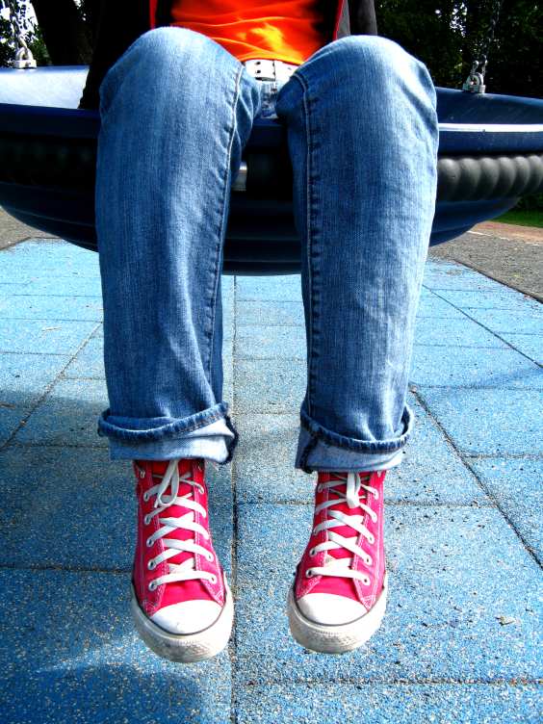
References
Kaiser, B., & Rasminsky, J. S. (2007). Challenging behavior in young children : Understanding, preventing, and responding effectively (2nd ed.). Boston, MA: Pearson Allyn and Bacon.
Kerr, M., M & Nelson, C. M. (2010). Strategies for addressing behavior problems in the classroom. Upper Saddle Ridge, NJ: Pearson Educational, Inc.
Worcester, J. A., Nesman, T. M., Mendez, L. M. R., & Keller, H. R. (2008). Giving voice to parents of young children with challenging behavior. Exceptional Children, 74(4), 509-525.
Photographs from
http://www.sxc.hu/home
Used with permission of photographers
Permission granted
Notes:
Photographs in this presentation come from www.sxc.hu/home and are used with the permission of the photographers. Thank you for listening and I hope this presentation was helpful.

